Slide 1
Modeling of Small Database-Derived and Random Gene Regulatory Networks Elucidates the Transcriptional Response to Cold Shock in Saccharomyces Cerevisiae
GRNmap Data Analysis Team
Kam D. Dahlquist, Ph.D. and Ben G. Fitzpatrick, Ph.D.
Departments of Biology and Mathematics
Loyola Marymount University
Fall 2016 — Fall 2017

Slide 2
Modeling of Six Related, Database-Derived GRNs
Notes:
Source: https://github.com/kdahlquist/DahlquistLab/blob/master/documents/NEW_BK_GRNmap_Testing_network_presentation-all-strains_20161030.pptx

Slide 3
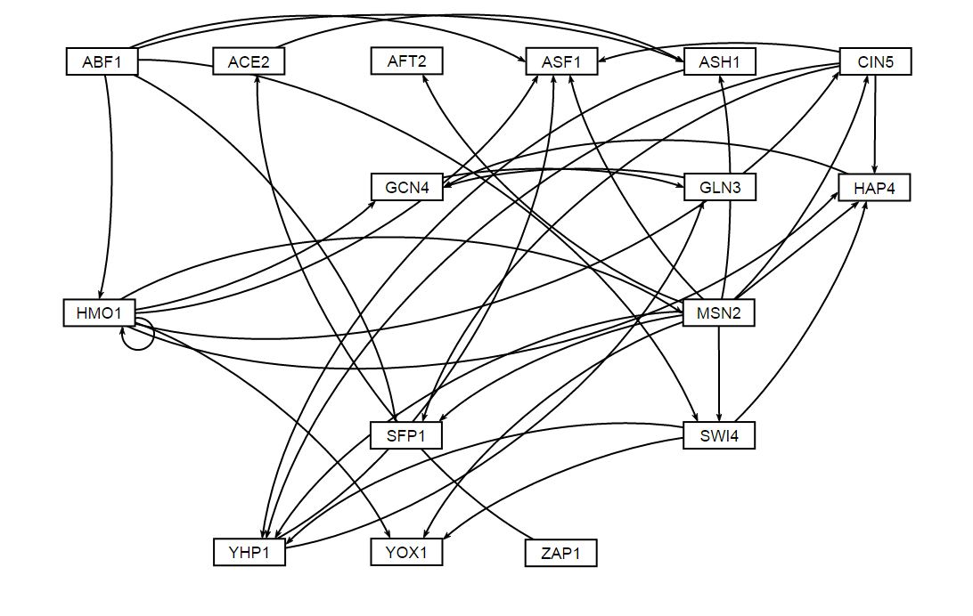
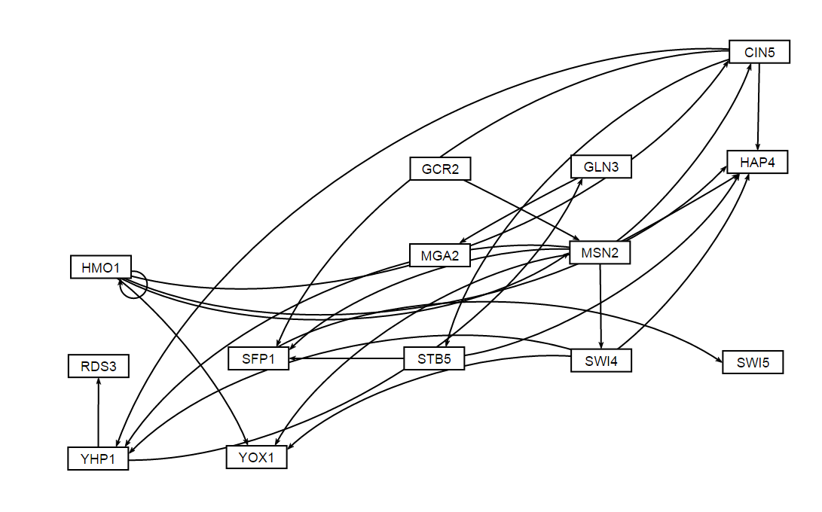
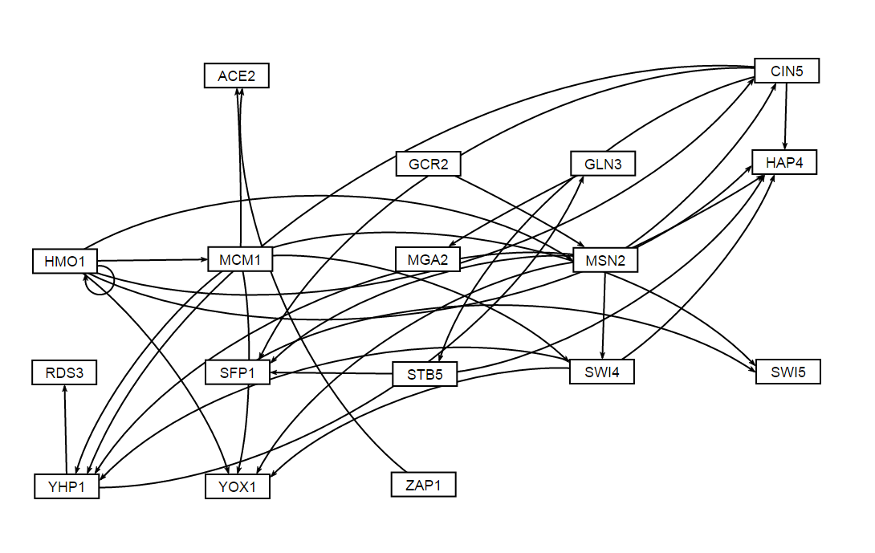
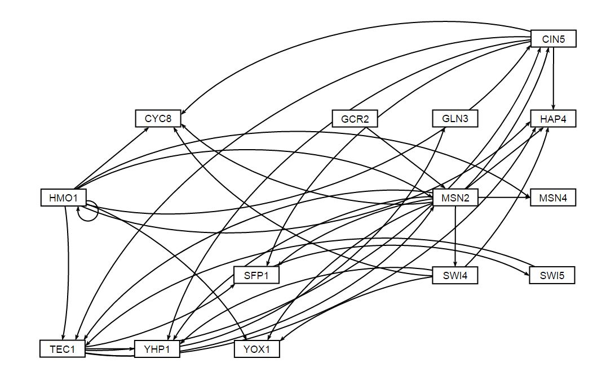
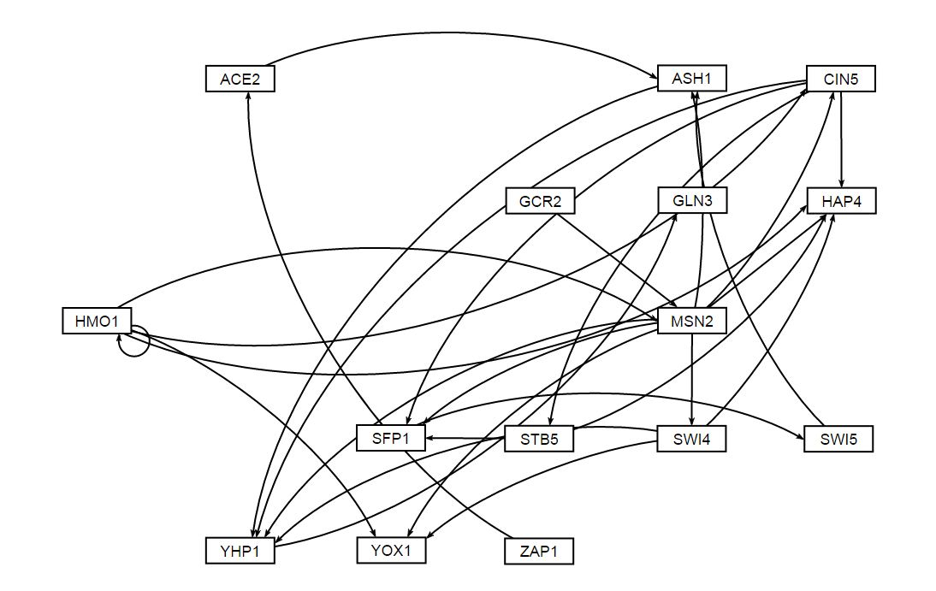
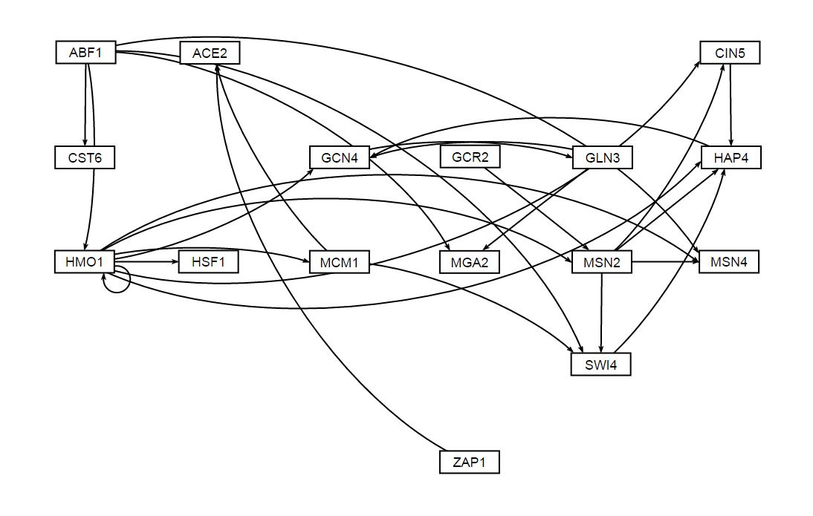
Unweighted Visualization of the 6 Database-Derived GRNs
db1: Network Derived from wt Data
16 Genes, 26 Edges
db2: Network Derived from ∆cin5 Data
14 Genes, 25 Edges
db3: Network Derived from ∆cin5 Data
17 Genes, 32 Edges
db4: Network Derived from ∆gln3 Data
14 Genes, 35 Edges
db5: Network Derived from ∆hap4 Data
15 Genes, 28 Edges
db6: Network Derived from ∆zap1 Data
16 Genes, 27 Edges
Notes:
Source: https://github.com/kdahlquist/DahlquistLab/blob/master/documents/NEW_BK_GRNmap_Testing_network_presentation-all-strains_20161030.pptx

Slide 4
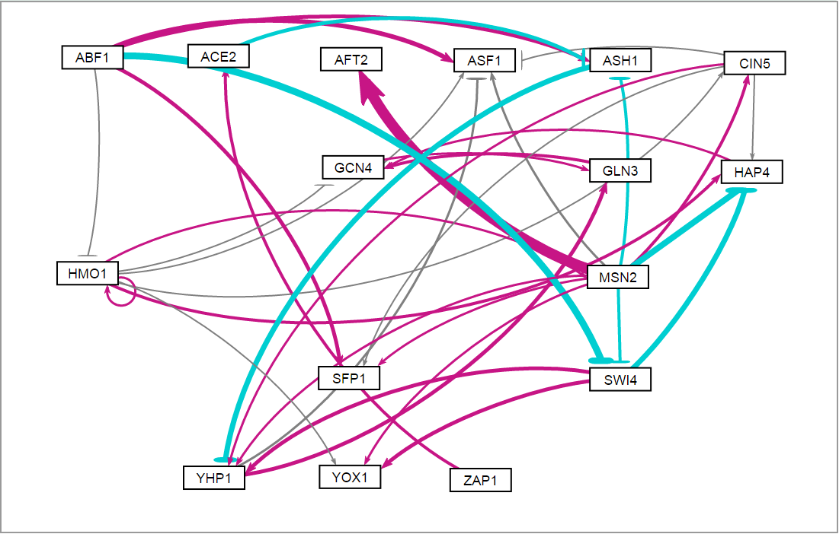
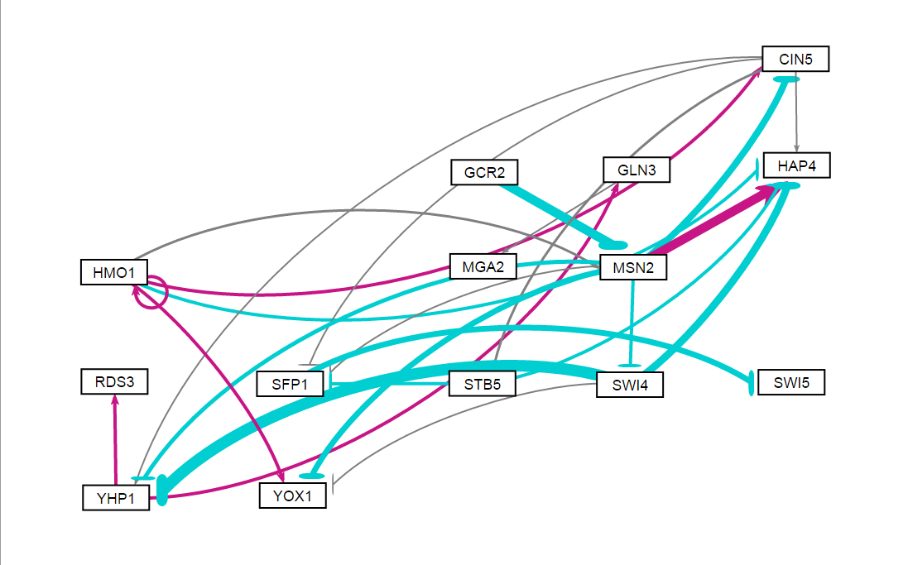
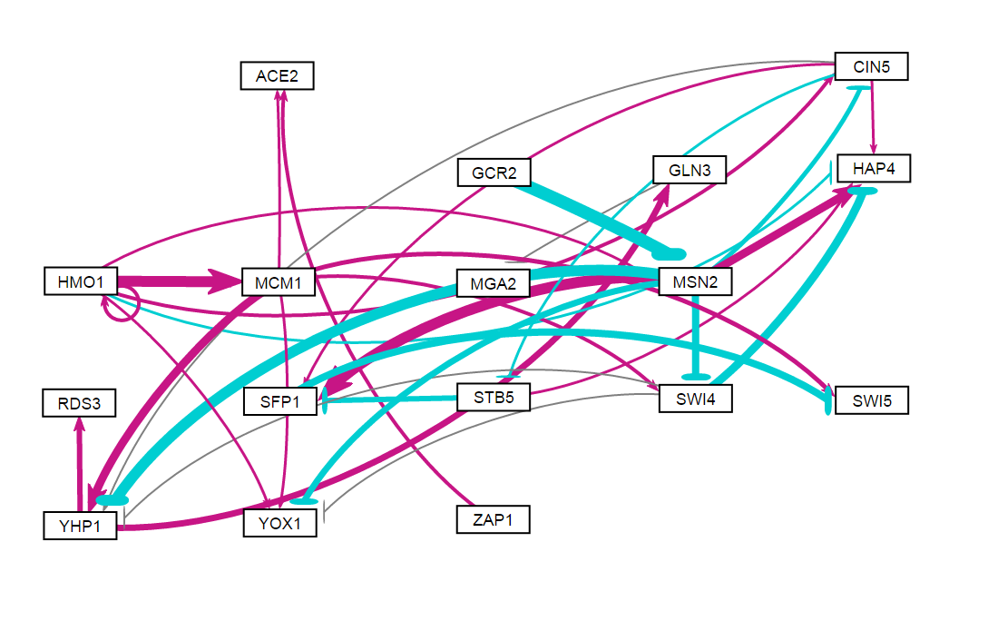
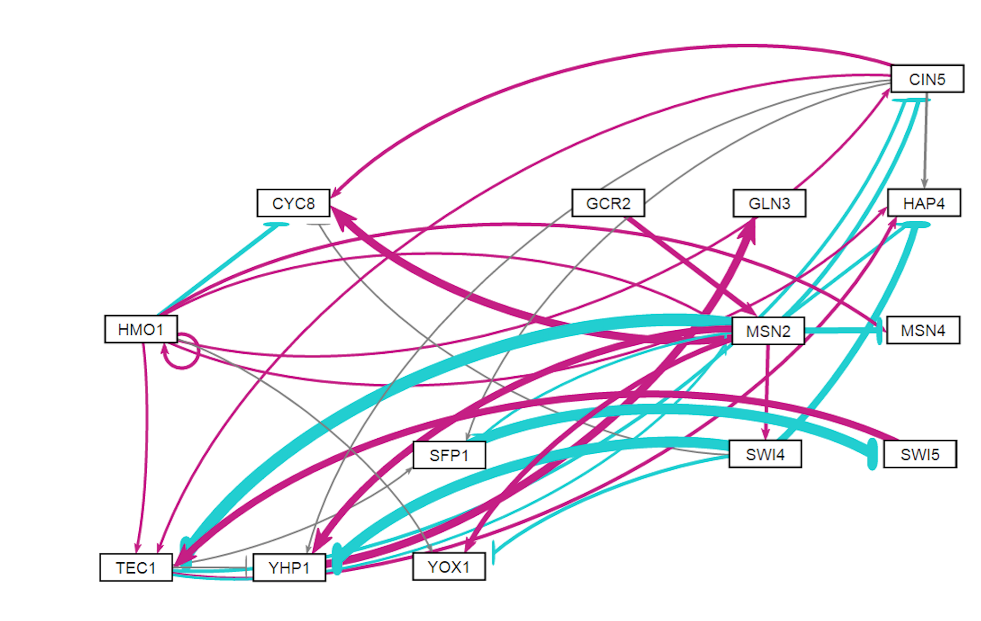
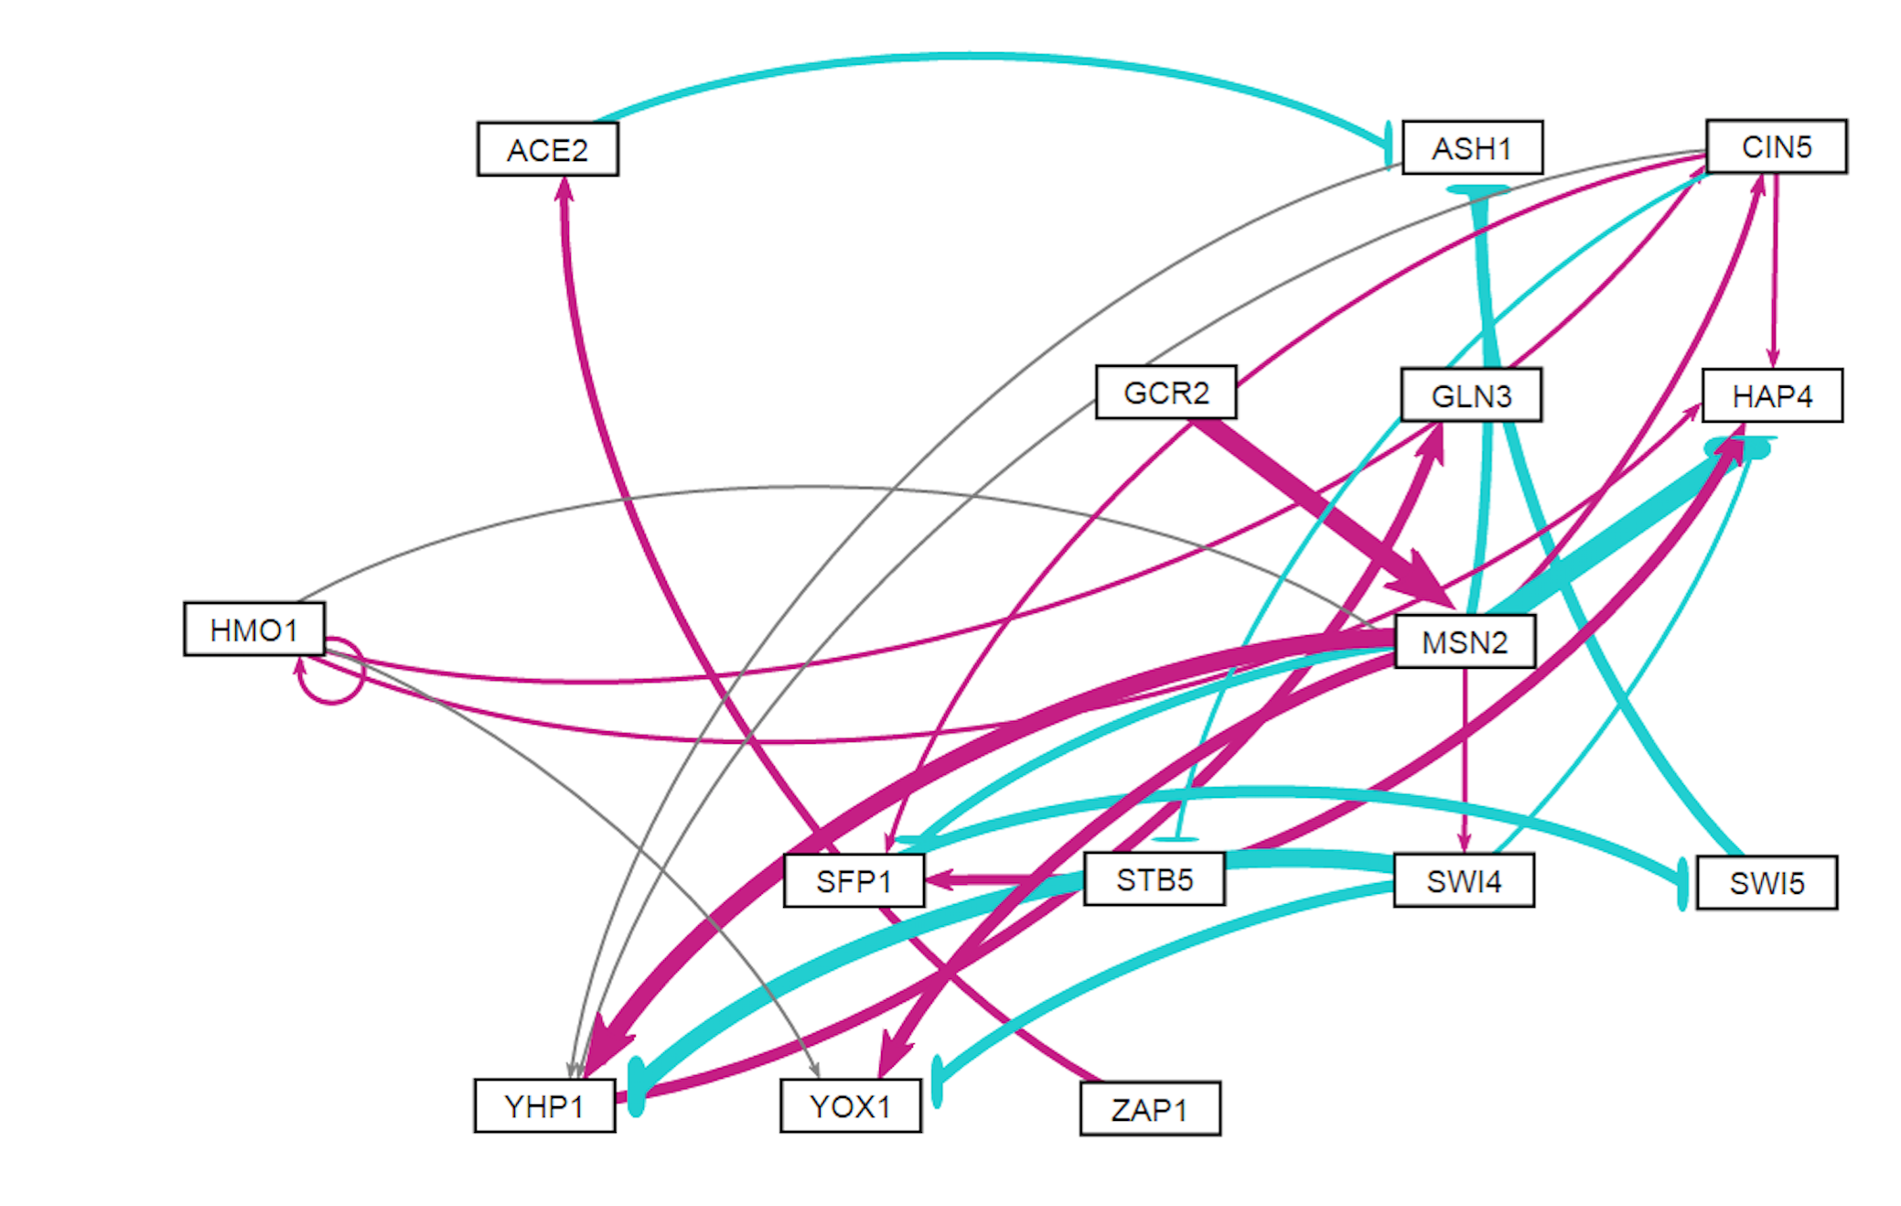
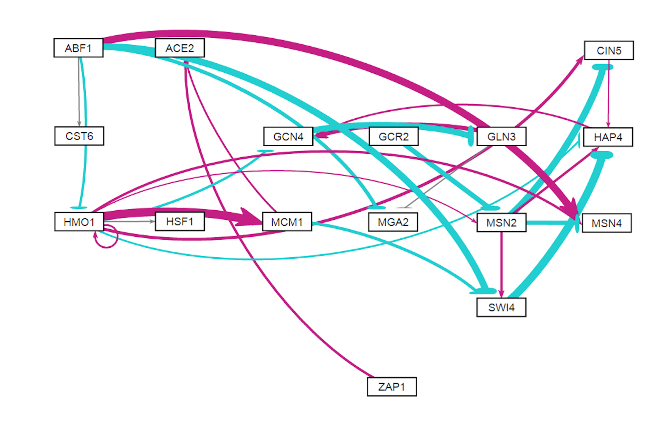
Weighted Visualization of the 6 Database-Derived GRNs
db1: Network Derived from wt Data
16 Genes, 26 Edges
db2: Network Derived from ∆cin5 Data
14 Genes, 25 Edges
db3: Network Derived from ∆cin5 Data
17 Genes, 32 Edges
db4: Network Derived from ∆gln3 Data
14 Genes, 35 Edges
db5: Network Derived from ∆hap4 Data
15 Genes, 28 Edges
db6: Network Derived from ∆zap1 Data
16 Genes, 27 Edges
Notes:
Source: https://github.com/kdahlquist/DahlquistLab/blob/master/documents/NEW_BK_GRNmap_Testing_network_presentation-all-strains_20161030.pptx

Slide 5
db1: Network Derived from WT Data
16 Genes, 26 Edges
Network composed of the following genes:
ABF1
ACE2
AFT2
ASF1
ASH1
CIN5
GCN4
GLN3
HAP4
HMO1
MSN2
SFP1
SWI4
YHP1
YOX1
ZAP1
Notes:
Source: https://github.com/kdahlquist/DahlquistLab/blob/master/documents/NEW_BK_GRNmap_Testing_network_presentation-all-strains_20161030.pptx

Slide 6
db1: Network Derived from wt Data
16 Genes, 26 Edges
Parameter | Value
Penalty Term | 2.5923
LSE | 0.8194
minLSE | 0.5768
LSE:minLSE ratio | 1.4206
Iteration Count | 109,718
Notes:
Source: https://github.com/kdahlquist/DahlquistLab/blob/master/documents/NEW_BK_GRNmap_Testing_network_presentation-all-strains_20161030.pptx

Slide 7
db1: Network Derived from wt Data
16 Genes, 26 Edges
16-genes_36-edges_db1_Sigmoid_estimation_missing-values_L-curve
Notes:
Source: https://github.com/kdahlquist/DahlquistLab/blob/master/documents/L-Curve-Analysis_Varied-Optimization-Data-Size_BK20170909.pptx
Issue 1: https://github.com/kdahlquist/GRNmap/issues/351
Issue 2: https://github.com/kdahlquist/GRNmap/issues/360

Slide 8
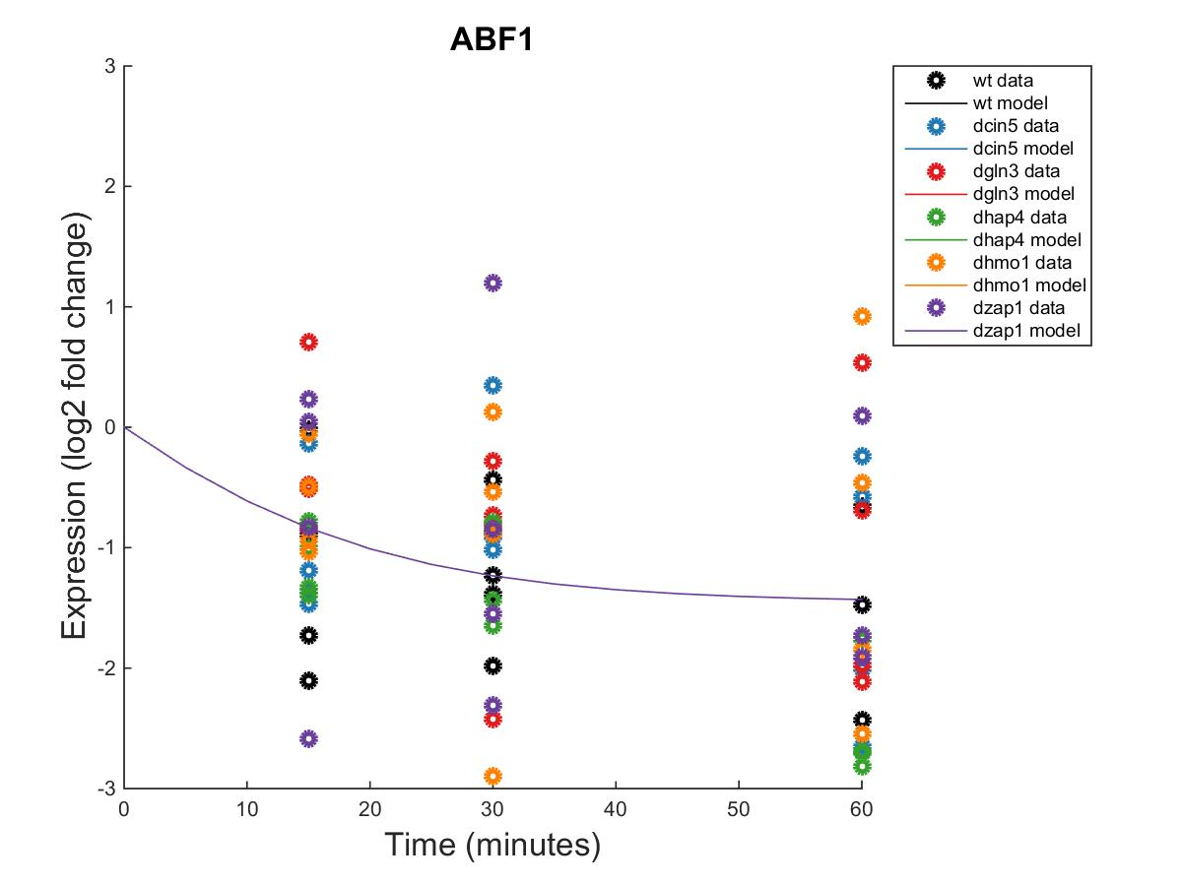
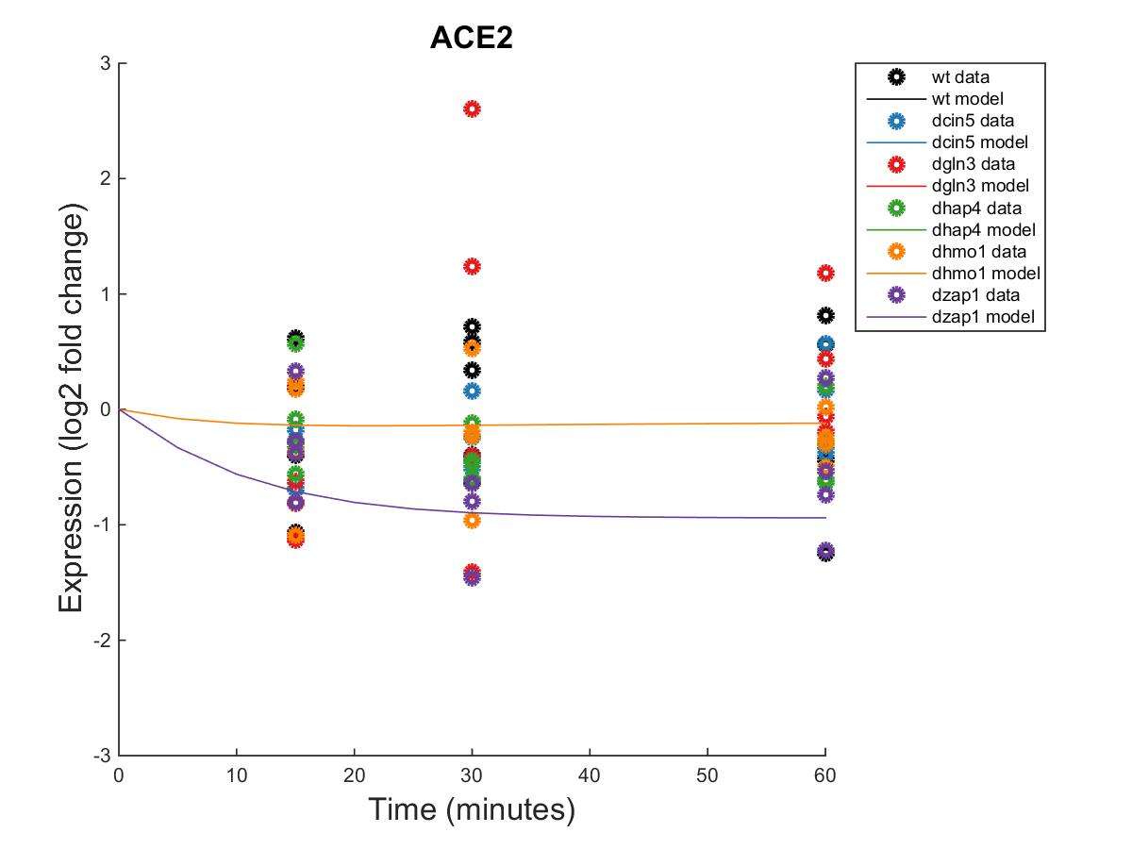
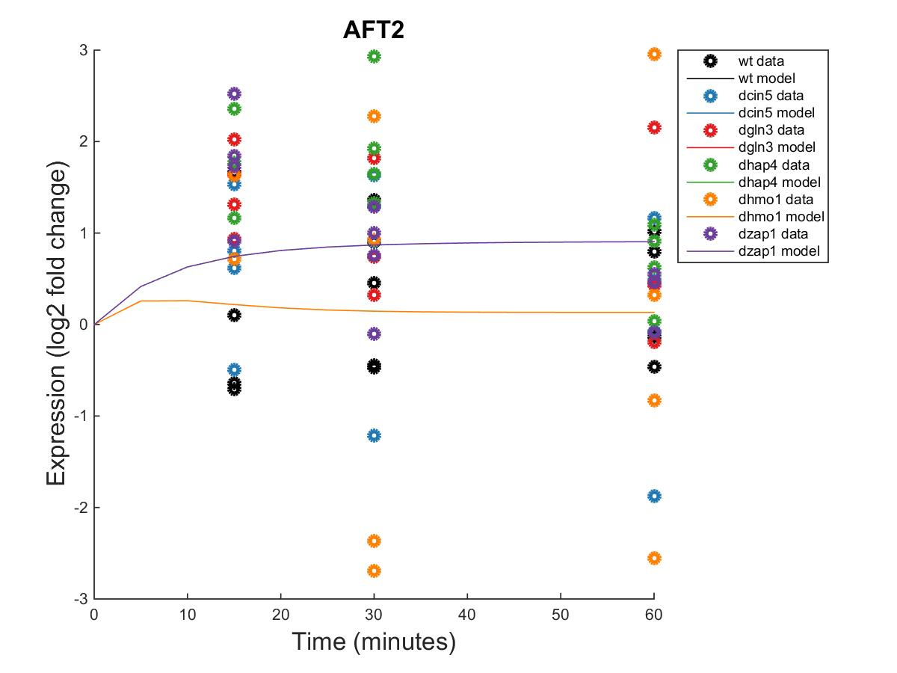
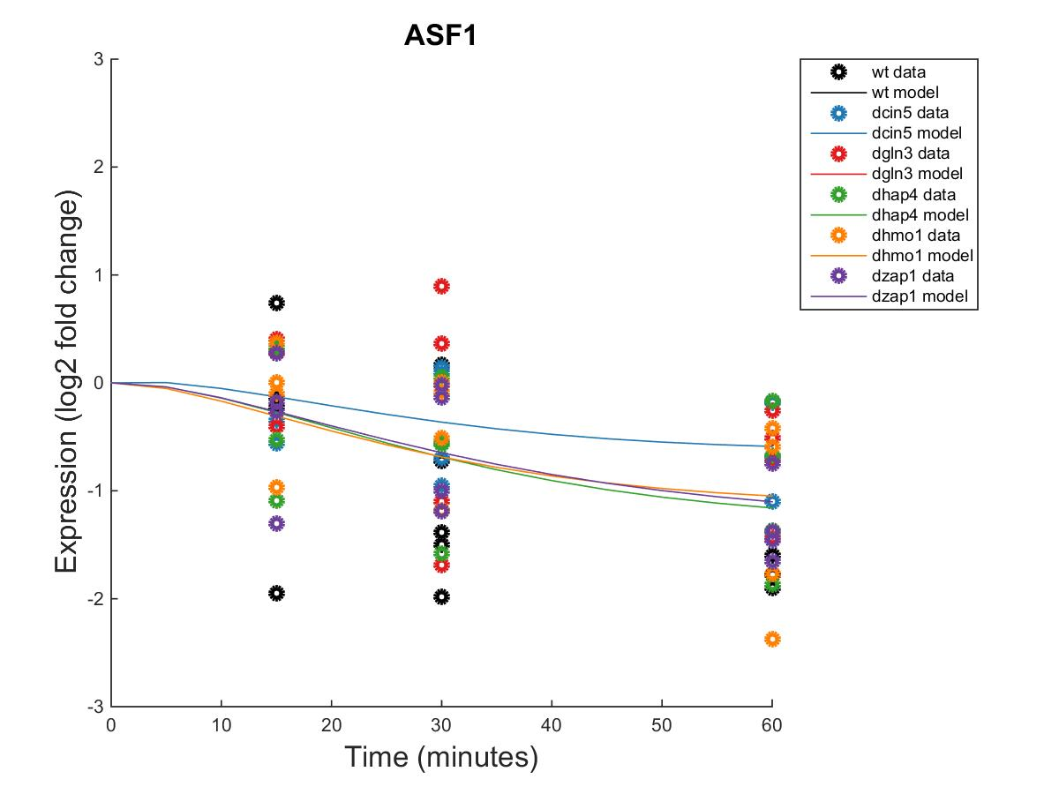
GRNmap Output Estimation of ABF1, ACE2, AFT2, and ASF1
Within Strain ANOVA
0.0055
0.0148
0.1095
0.0004
0.5993
0.0895
Within Strain ANOVA
0.7624
0.4462
0.7855
0.2916
0.8258
0.0457
Within Strain ANOVA
0.9361
0.7004
0.0343
0.0045
0.993
0.0159
Within Strain ANOVA
0.0298
0.4193
0.4165
0.2305
0.8447
0.1669
Notes:
Source: https://github.com/kdahlquist/DahlquistLab/blob/master/documents/NEW_BK_GRNmap_Testing_network_presentation-all-strains_20161030.pptx

Slide 9
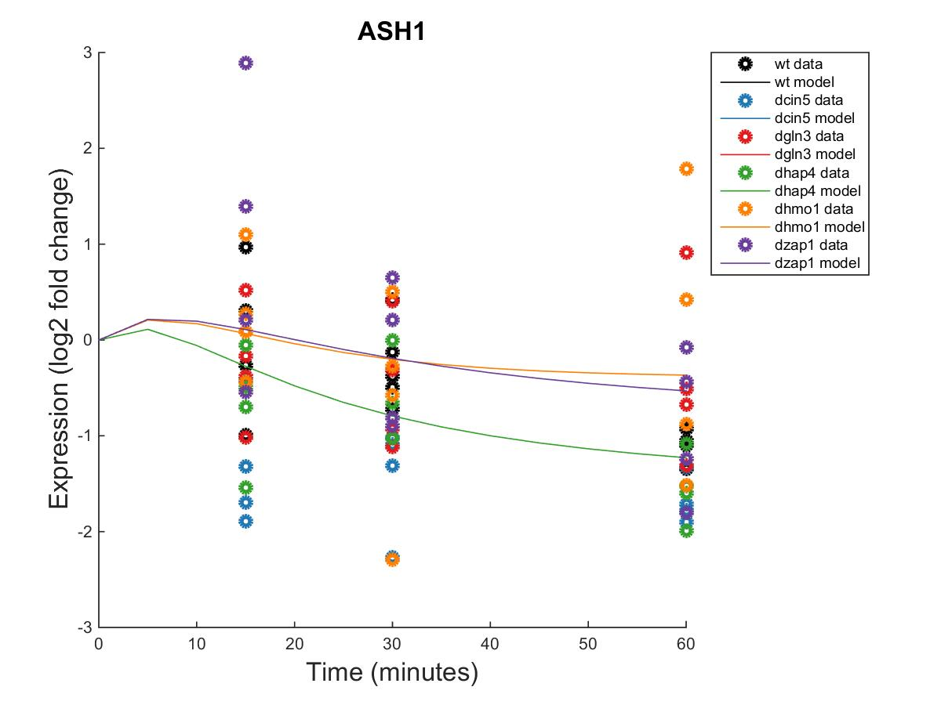
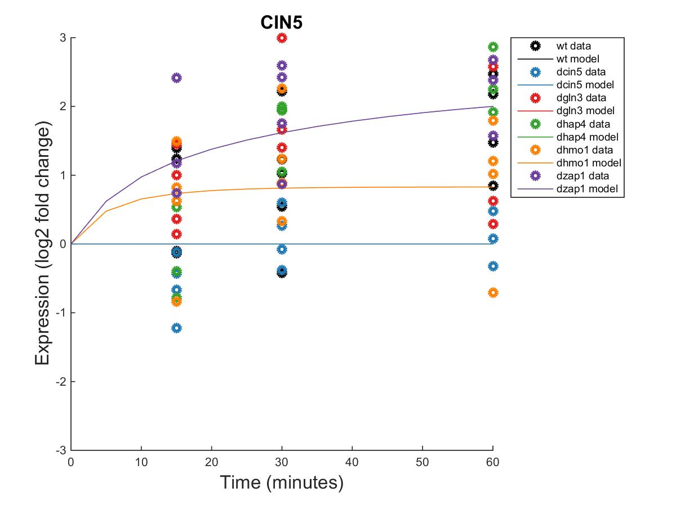
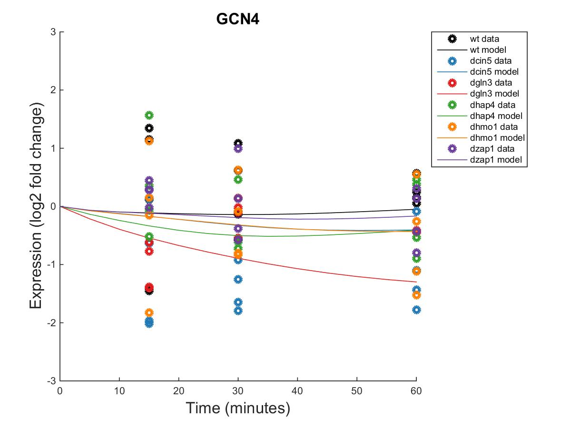
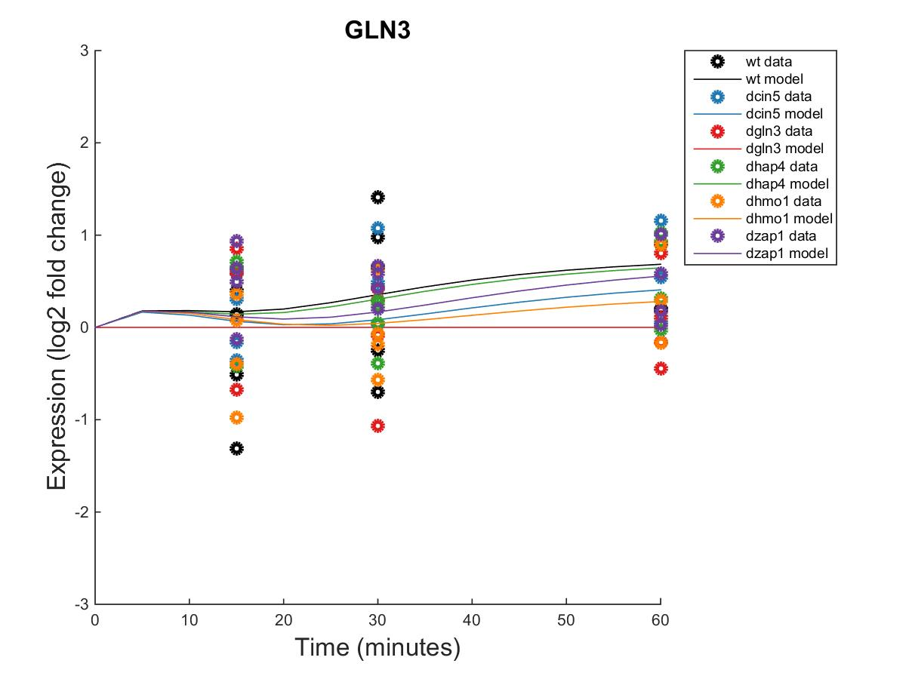
GRNmap Output Estimation of ASH1, CIN5, GCN4, and GLN3
Within Strain ANOVA
0.0829
0.0091
0.5202
0.0723
0.7639
0.4535
Within Strain ANOVA
0.0662
0.6188
0.0163
0.0112
0.4113
0.026
Within Strain ANOVA
0.6297
0.2761
0.2751
0.5058
0.9118
0.5207
Within Strain ANOVA
0.4189
0.5468
0.6094
0.5189
0.9281
0.1171
Notes:
Source: https://github.com/kdahlquist/DahlquistLab/blob/master/documents/NEW_BK_GRNmap_Testing_network_presentation-all-strains_20161030.pptx

Slide 10
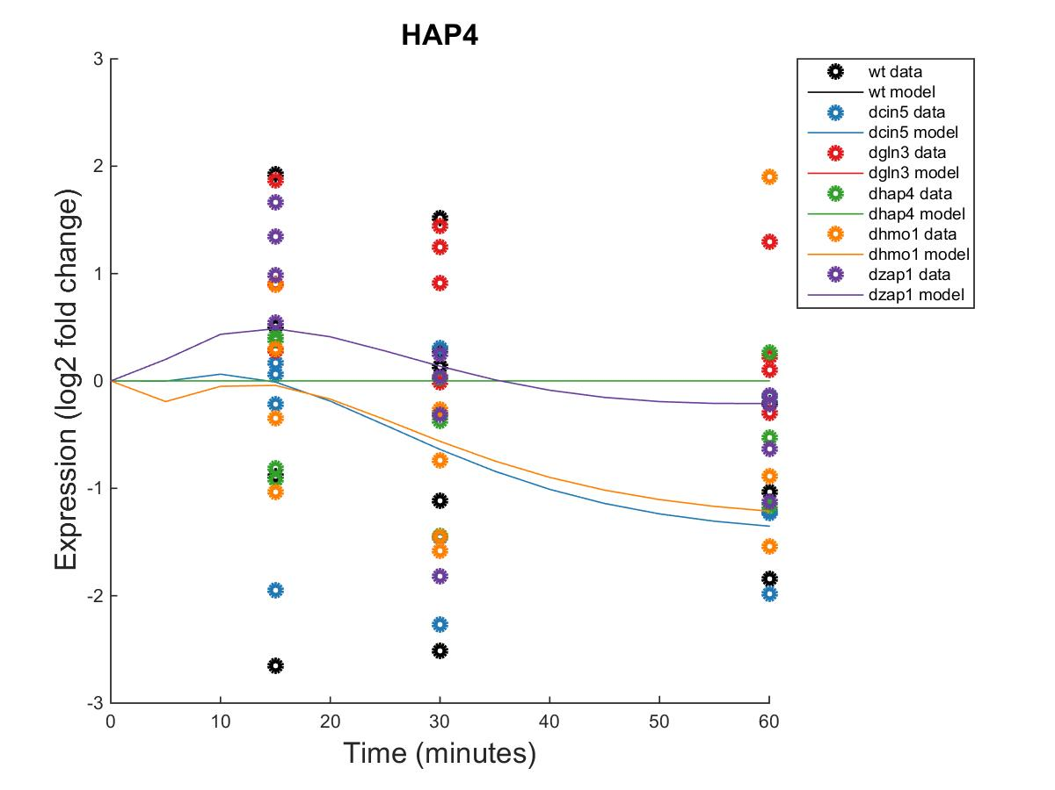
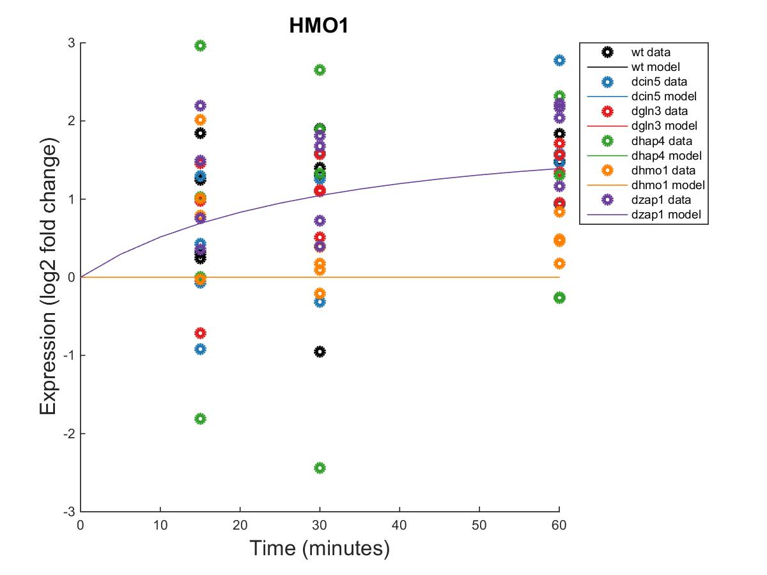
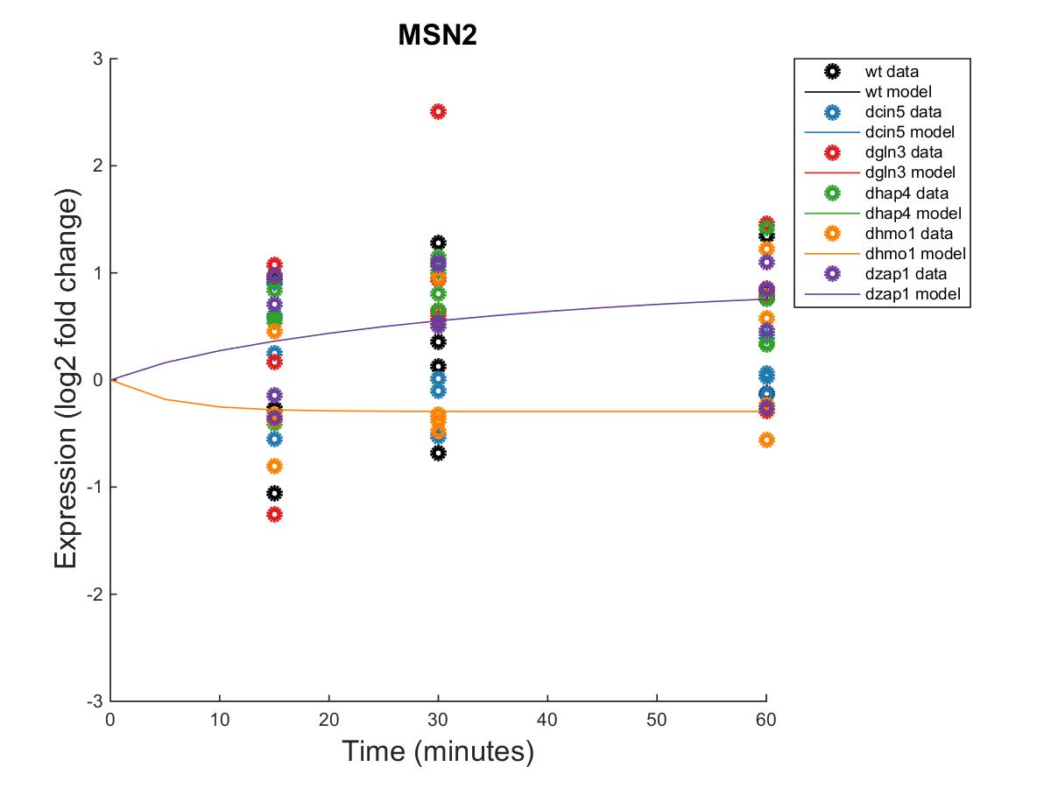
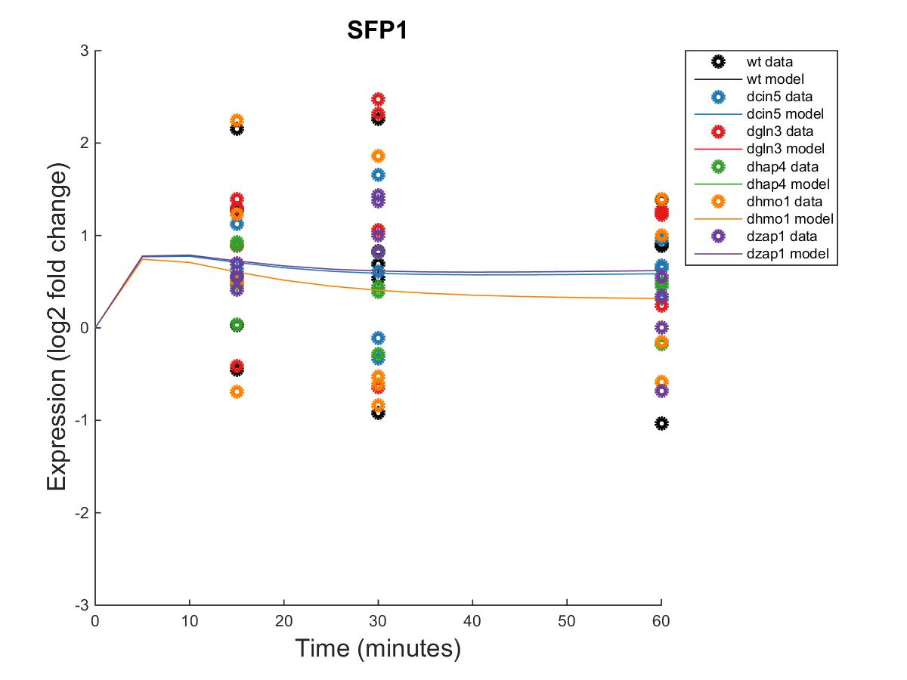
GRNmap Output Estimation of HAP4, HMO1, MSN2, and SFP1
Within Strain ANOVA
0.7307
0.4821
0.0773
0.4165
0.9262
0.0157
Within Strain ANOVA
0.0397
0.0022
0.0025
0.4244
0.5758
0.0011
Within Strain ANOVA
0.3056
0.2208
0.3427
0.0168
0.8021
0.0836
Within Strain ANOVA
0.4097
0.0494
0.0751
0.0533
0.8354
0.0021
Notes:
Source: https://github.com/kdahlquist/DahlquistLab/blob/master/documents/NEW_BK_GRNmap_Testing_network_presentation-all-strains_20161030.pptx

Slide 11
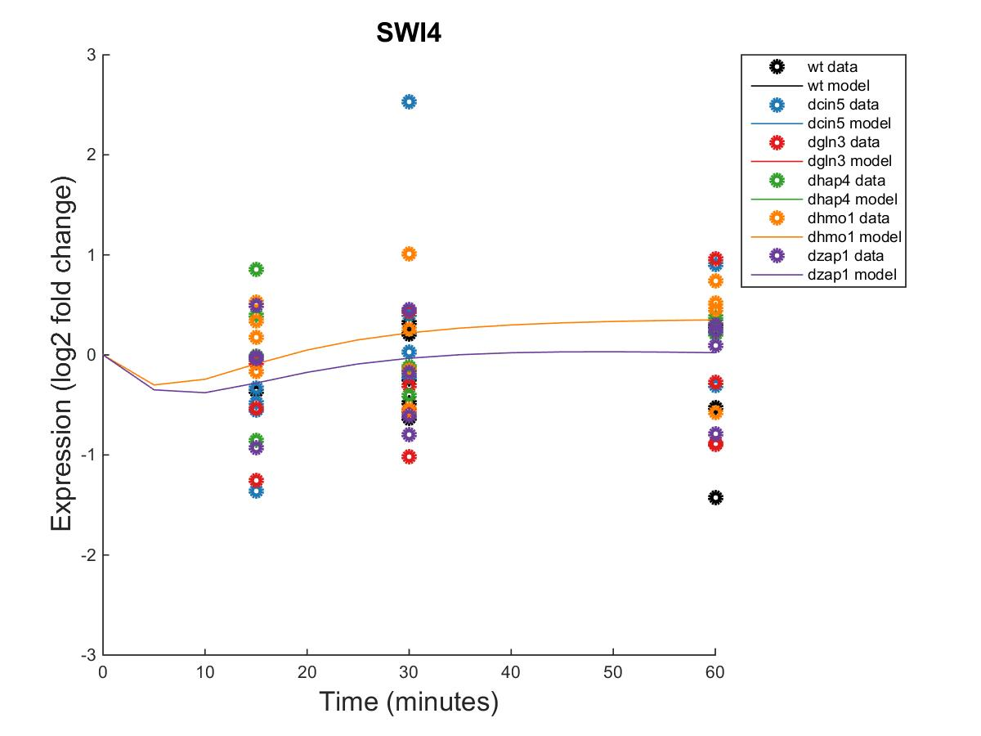
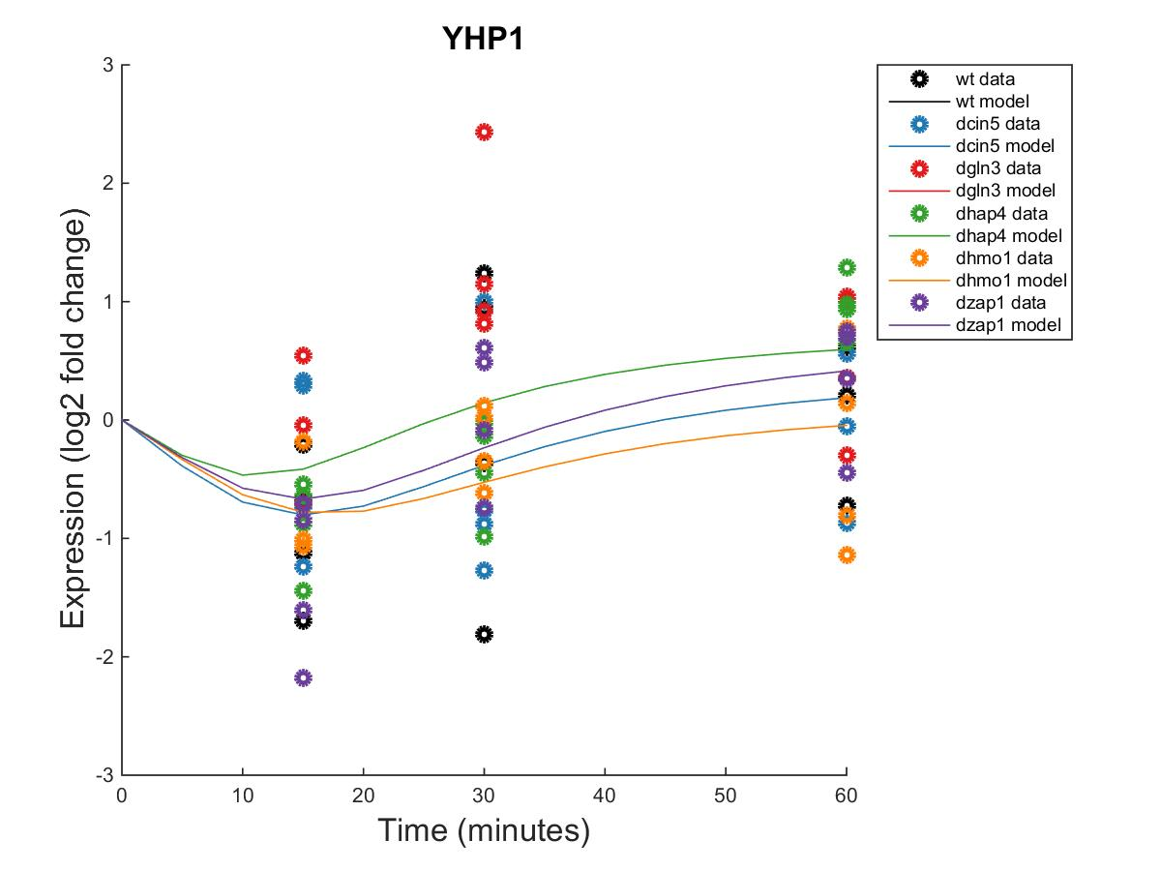
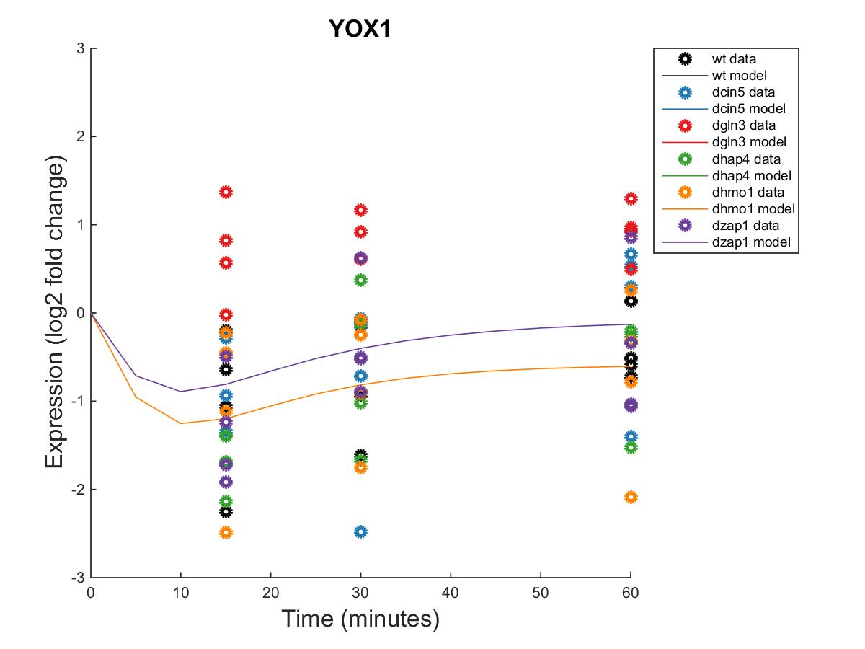
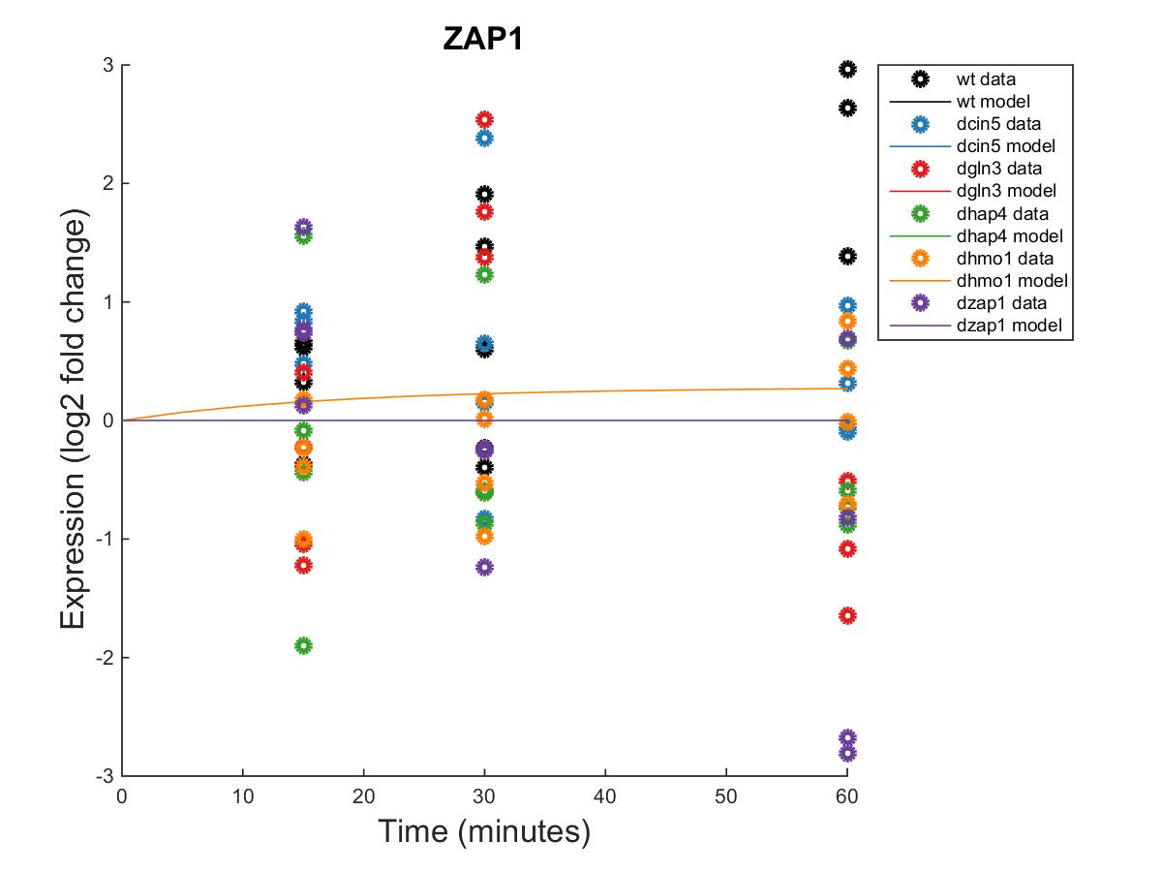
GRNmap Output Estimation of SWI4, YHP1, YOX1, and ZAP1
Within Strain ANOVA
0.6731
0.4839
0.3797
0.6155
0.9652
0.7799
Within Strain ANOVA
0.1743
0.8684
0.0433
0.0084
0.8152
0.0653
Within Strain ANOVA
0.004
0.058
0.2181
0.0117
0.2197
0.2658
Within Strain ANOVA
0.0089
0.316
0.2503
1.0134
0.8824
0.4562
Notes:
Source: https://github.com/kdahlquist/DahlquistLab/blob/master/documents/NEW_BK_GRNmap_Testing_network_presentation-all-strains_20161030.pptx

Slide 12
db1: Network Derived from wt Data
16 Genes, 26 Edges
db1 appears to have more activation than repression of genes within the network.
Notes:
Source: https://github.com/kdahlquist/DahlquistLab/blob/master/documents/NEW_BK_GRNmap_Testing_network_presentation-all-strains_20161030.pptx

Slide 13
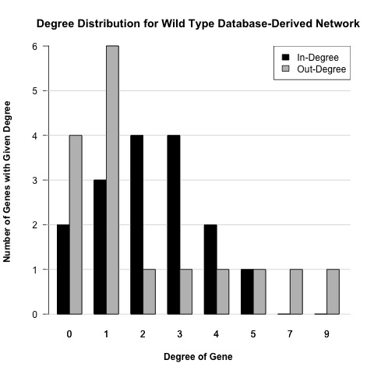
db1: Network Derived from wt Data
16 Genes, 26 Edges
Notes:
Source: https://github.com/kdahlquist/DahlquistLab/blob/master/documents/NEW_BK_GRNmap_Testing_network_presentation-all-strains_20161030.pptx

Slide 14
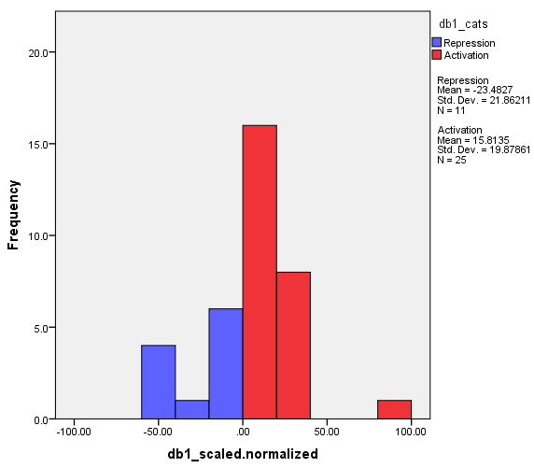
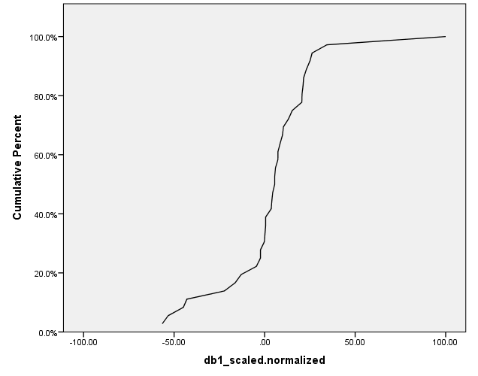
Distribution of db1 Regulatory Weights Network: 16 Genes, 36 Edges
Notes:
Source: https://github.com/kdahlquist/DahlquistLab/blob/master/documents/Weight-Distributions_Six-Networks_BK2017213.pptx
Issue: https://github.com/kdahlquist/GRNmap/issues/315

Slide 15
db1: Network Derived from wt Data
16 Genes, 26 Edges
id | Optimized production_rate | threshold_b
ABF1 | 0.0576 | 0.0576
ACE2 | 0.1339 | 0.2621
AFT2 | 0.2900 | 4.5169
ASF1 | 0.1582 | 1.3581
ASH1 | 1.5299 | 0.7641
CIN5 | 1.1528 | 2.6976
GCN4 | 0.1812 | 2.4228
GLN3 | 0.3601 | 1.3441
HAP4 | 2.3448 | -1.7451
HMO1 | 0.4833 | 1.3129
MSN2 | 0.5739 | 0.8961
SFP1 | 1.0066 | 1.2433
SWI4 | 0.2278 | -3.3941
YHP1 | 0.1513 | 0.3128
YOX1 | 0.7856 | 2.9816
ZAP1 | 0.1265 | 0.1265
Notes:
Source: https://github.com/kdahlquist/DahlquistLab/blob/master/documents/NEW_BK_GRNmap_Testing_network_presentation-all-strains_20161030.pptx

Slide 16
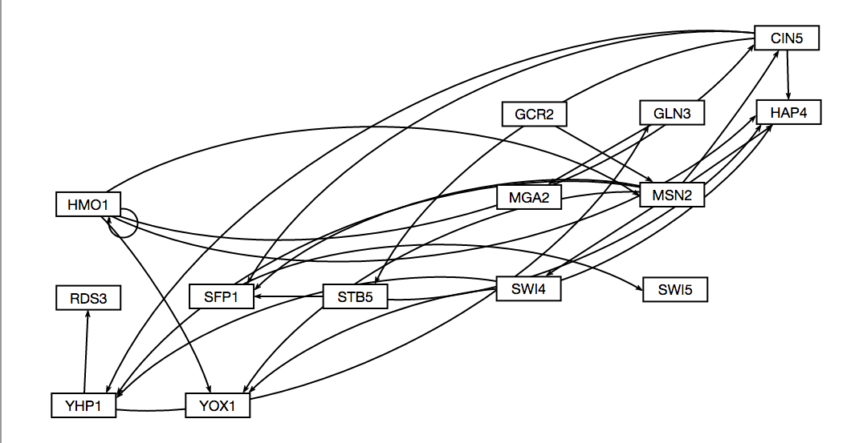
db2: Network Derived from ∆cin5 Data
14 Genes, 25 Edges
Network Composed of the following genes:
CIN5
GCR2
GLN3
HAP4
HMO1
MGA2
MSN2
RDS3
SFP1
STB5
SWI4
SWI5
YHP1
YOX1
Notes:
Source: https://github.com/kdahlquist/DahlquistLab/blob/master/documents/NEW_BK_GRNmap_Testing_network_presentation-all-strains_20161030.pptx

Slide 17
db2: Network Derived from ∆cin5 Data
14 Genes, 25 Edges
Parameter | Value
Penalty Term | 1.8830
LSE | 0.6634
minLSE | 0.4885
LSE:minLSE ratio | 1.3580
Iteration Count | 53,862
Notes:
Source: https://github.com/kdahlquist/DahlquistLab/blob/master/documents/NEW_BK_GRNmap_Testing_network_presentation-all-strains_20161030.pptx

Slide 18
14-gene_25-edges_db2_Sigmoid_estimation_missing-values_L-curve
db2: Network Derived from ∆cin5 Data
14 Genes, 25 Edges
Notes:
Source: https://github.com/kdahlquist/DahlquistLab/blob/master/documents/L-Curve-Analysis_Varied-Optimization-Data-Size_BK20170909.pptx
Issue 1: https://github.com/kdahlquist/GRNmap/issues/351
Issue 2: https://github.com/kdahlquist/GRNmap/issues/360

Slide 19
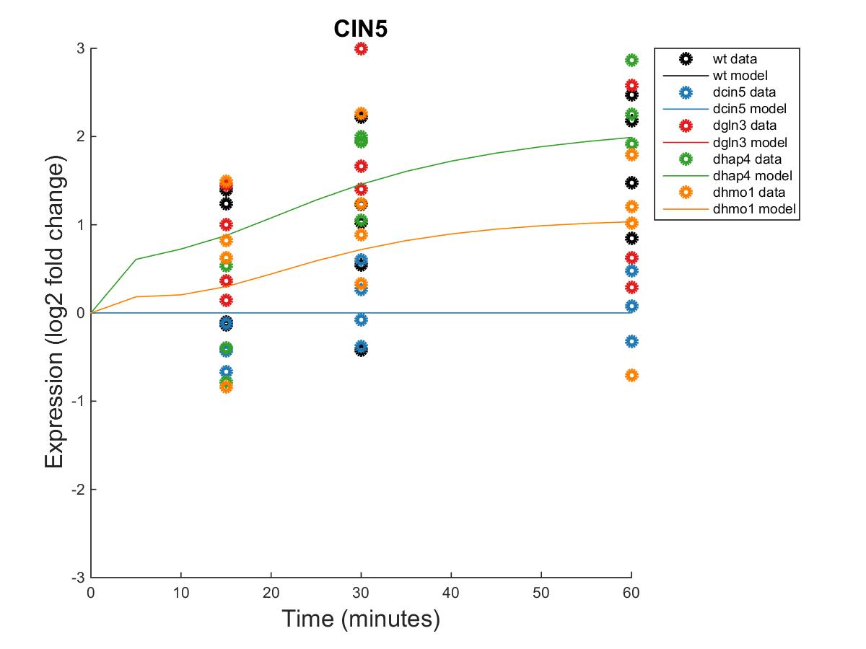
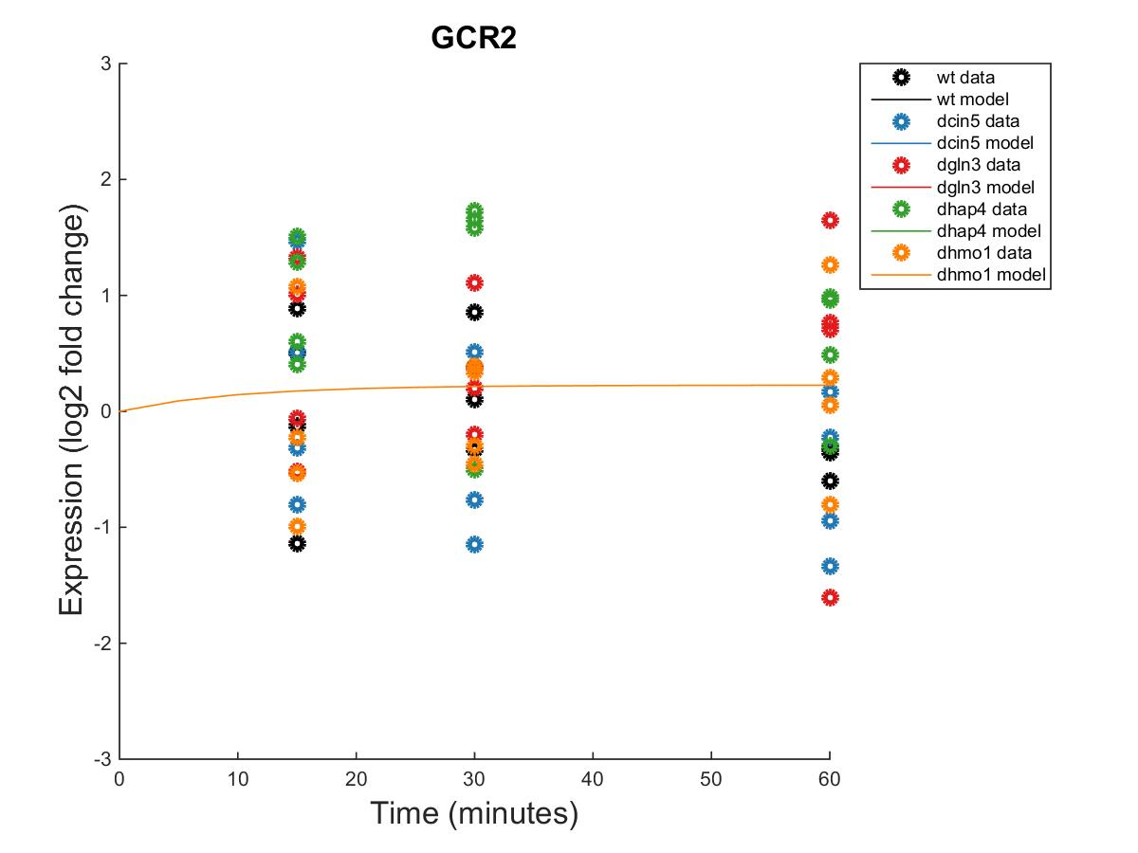
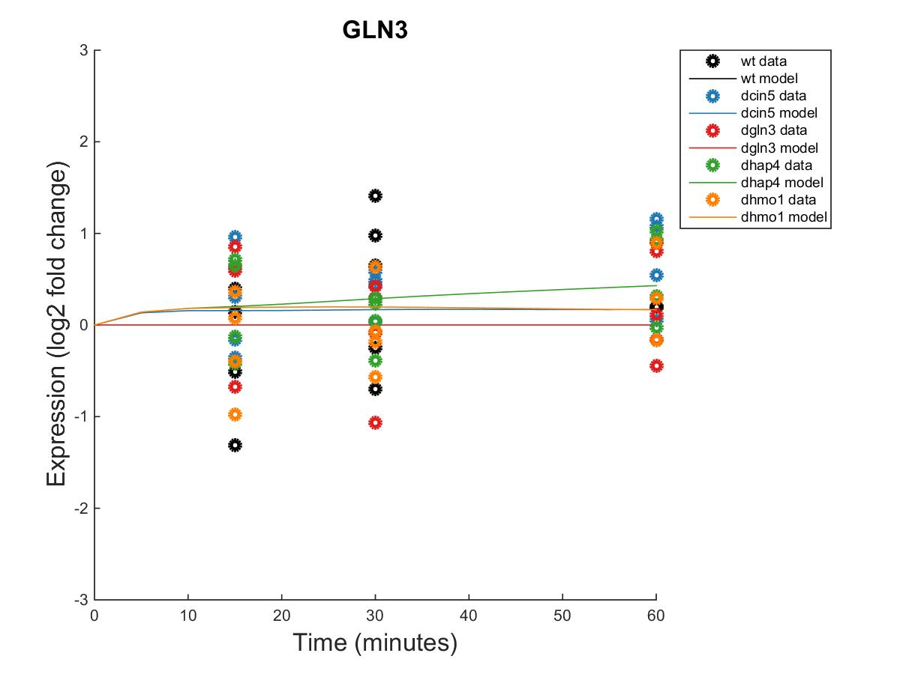
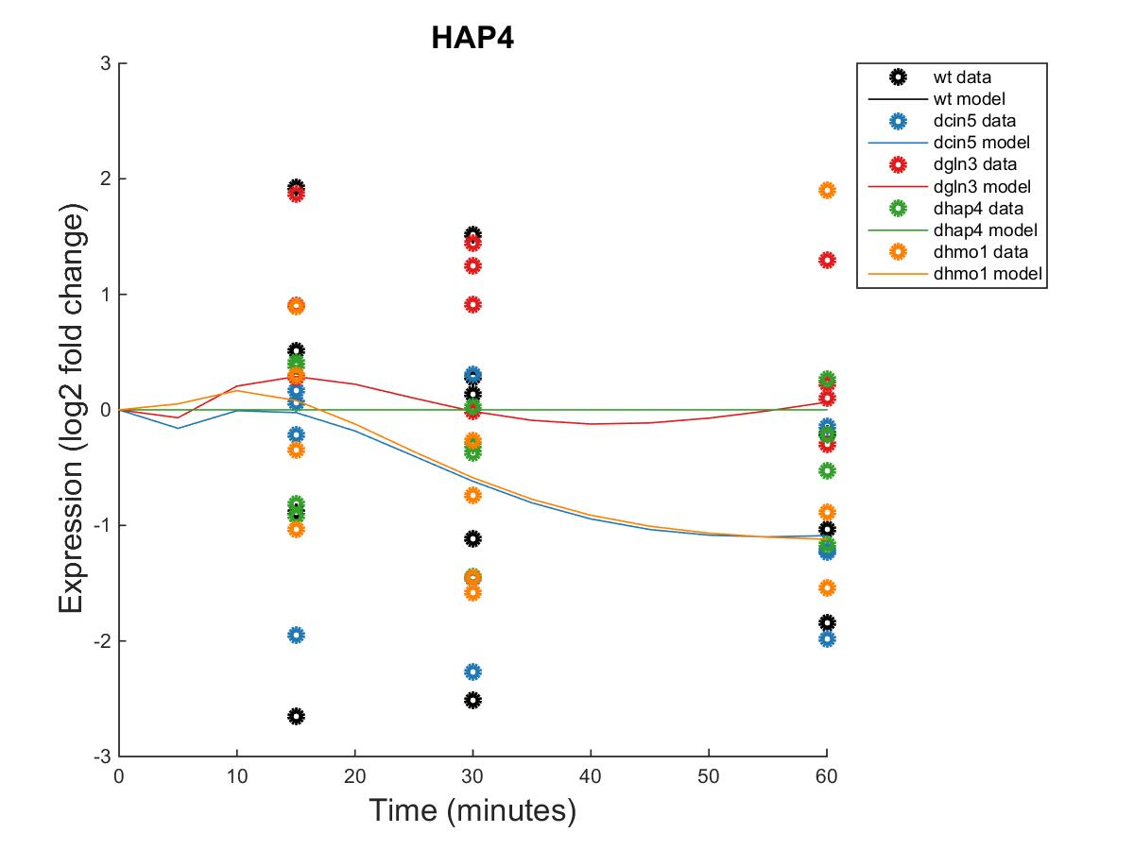
GRNmap Output Estimation of CIN5, GCR2, GLN3 and HAP4
Within Strain ANOVA
0.0662
0.6188
0.0163
0.0112
0.4113
Within Strain ANOVA
0.3306
0.5876
0.8763
0.1261
0.8445
Within Strain ANOVA
0.4189
0.5468
0.6094
0.5189
0.9281
Within Strain ANOVA
0.7307
0.4821
0.0773
0.4165
0.9262
Notes:
Source: https://github.com/kdahlquist/DahlquistLab/blob/master/documents/NEW_BK_GRNmap_Testing_network_presentation-all-strains_20161030.pptx

Slide 20
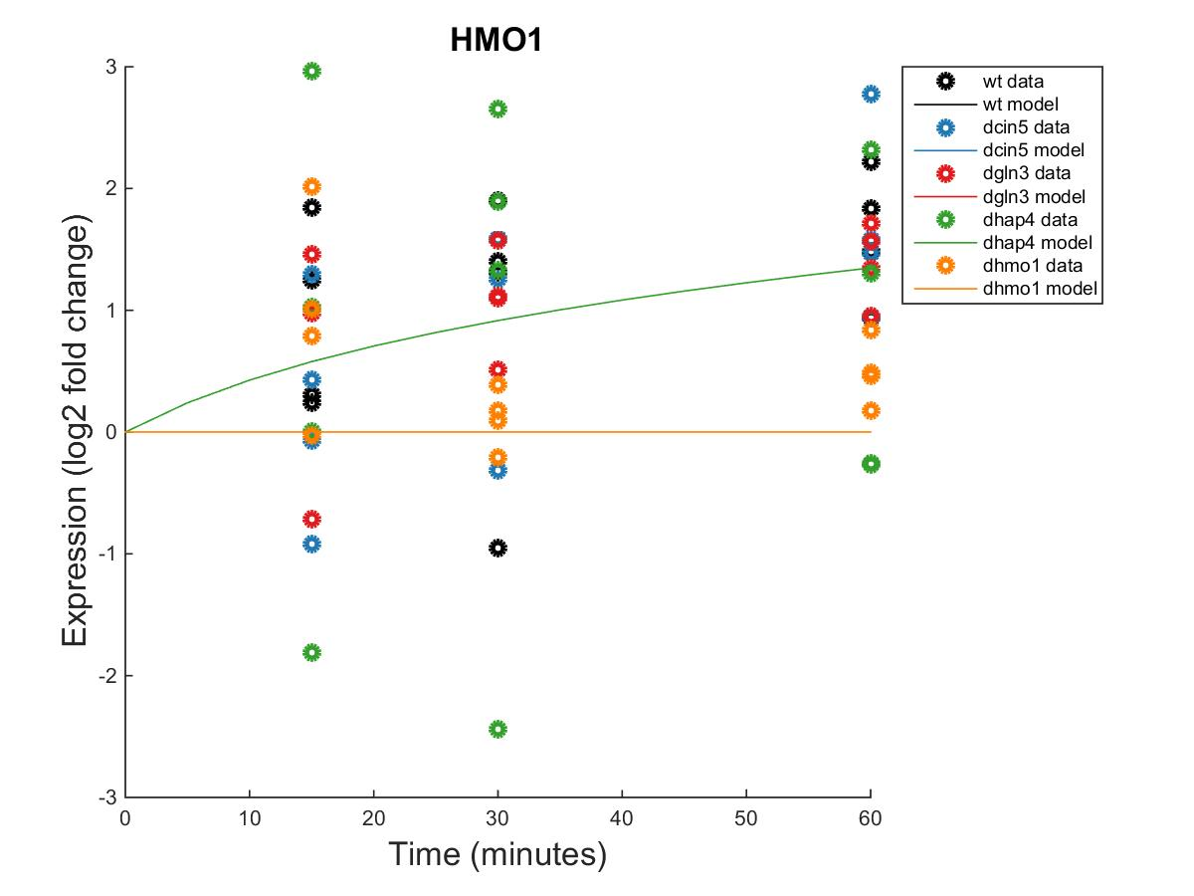
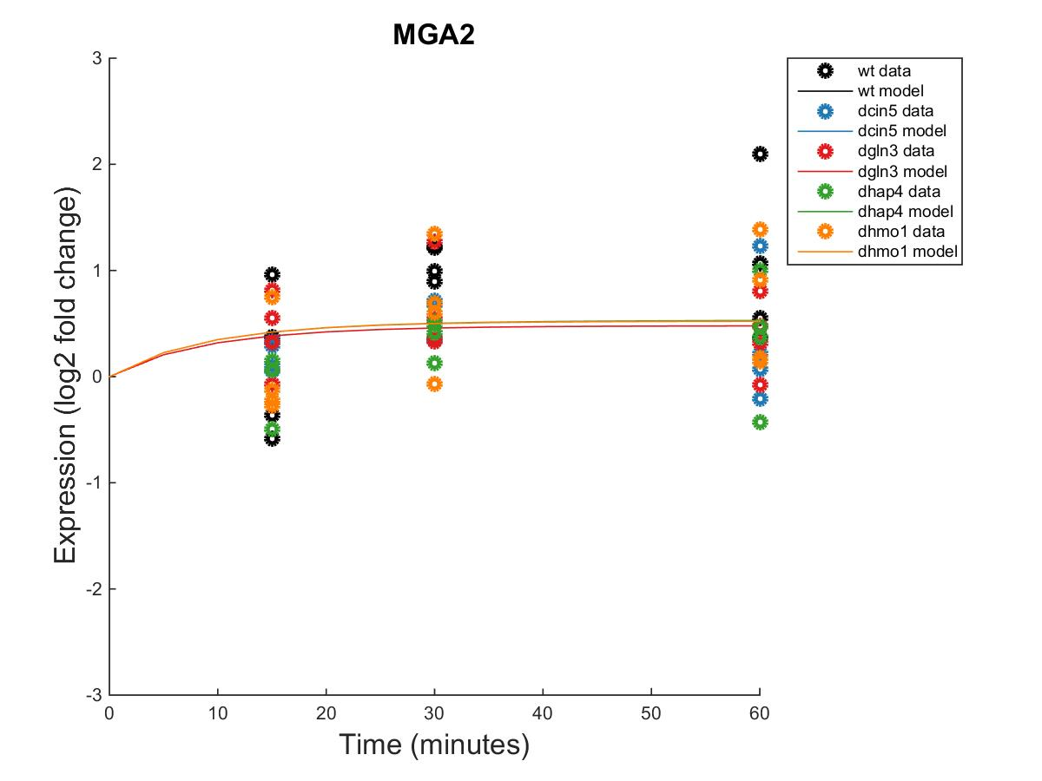
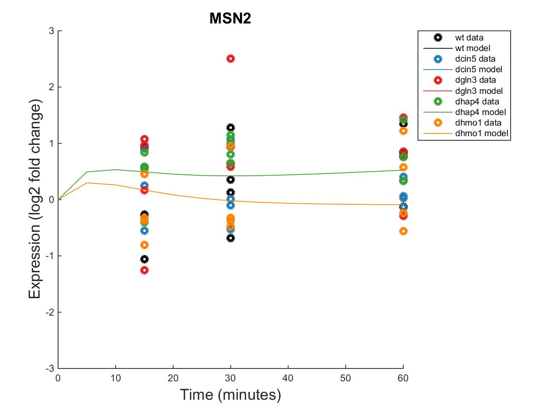
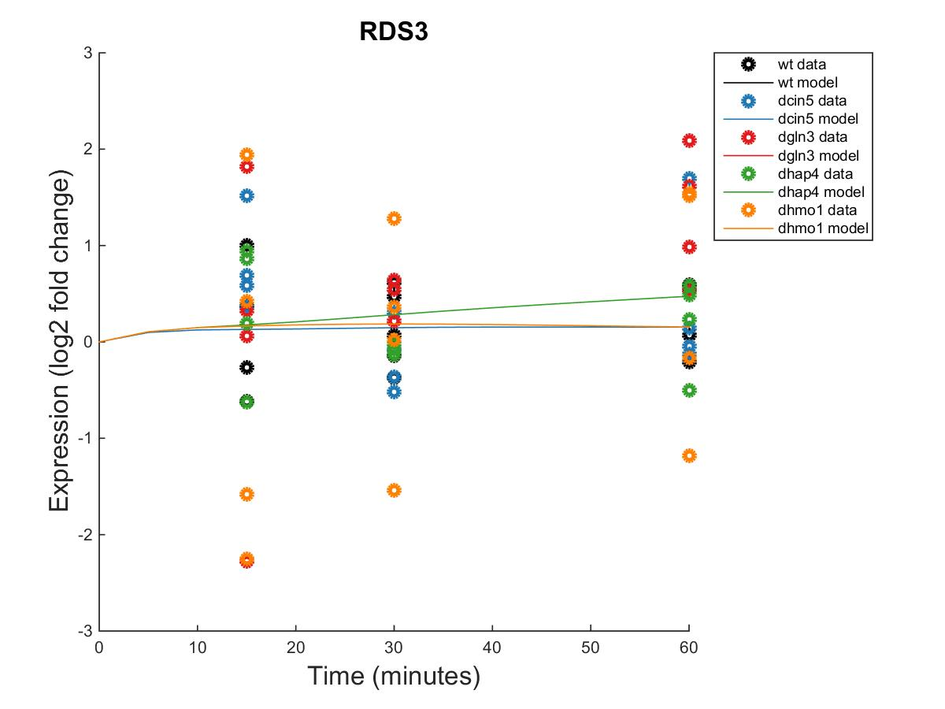
GRNmap Output Estimation of HMO1, MGA2, MSN2, and RDS3
Within Strain ANOVA
0.0397
0.0022
0.0025
0.4244
0.5758
Within Strain ANOVA
0.0996
0.3003
0.4415
0.3822
0.4679
Within Strain ANOVA
0.3056
0.2208
0.3427
0.0168
0.8021
Within Strain ANOVA
0.2952
0.6149
0.5967
0.8469
1.0057
Notes:
Source: https://github.com/kdahlquist/DahlquistLab/blob/master/documents/NEW_BK_GRNmap_Testing_network_presentation-all-strains_20161030.pptx

Slide 21
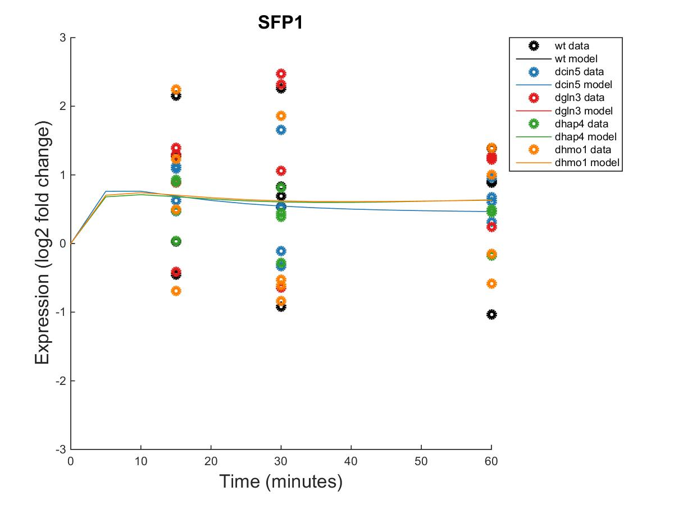
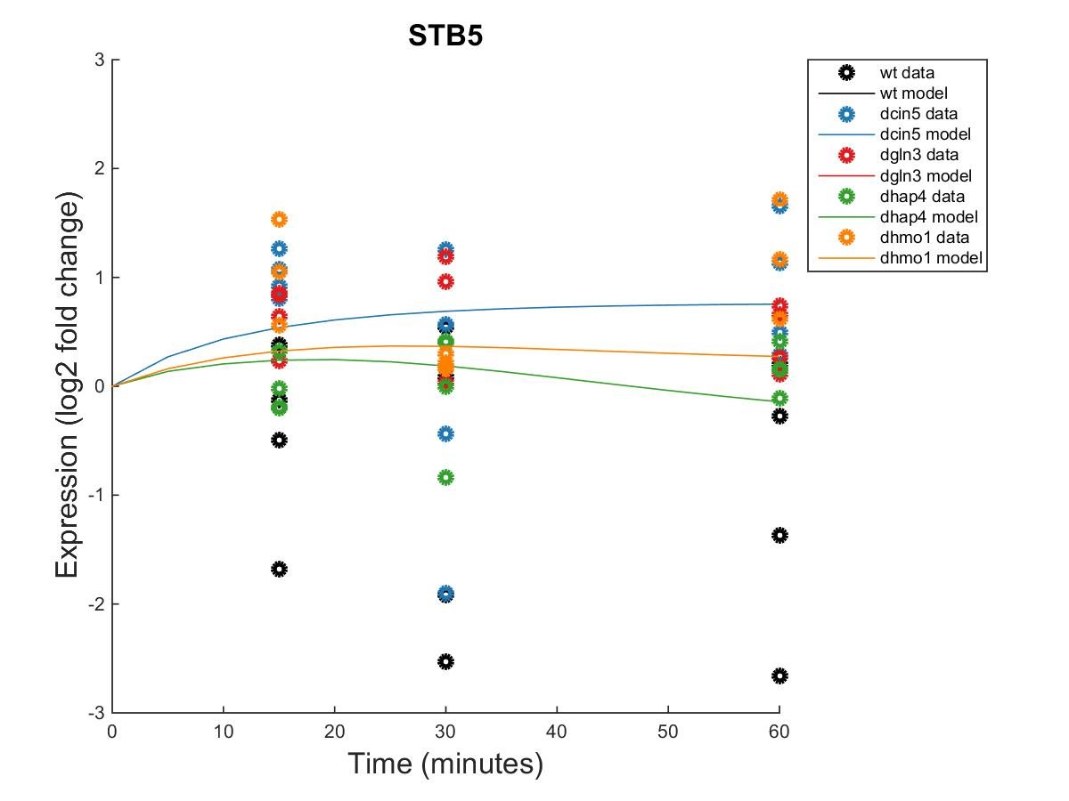
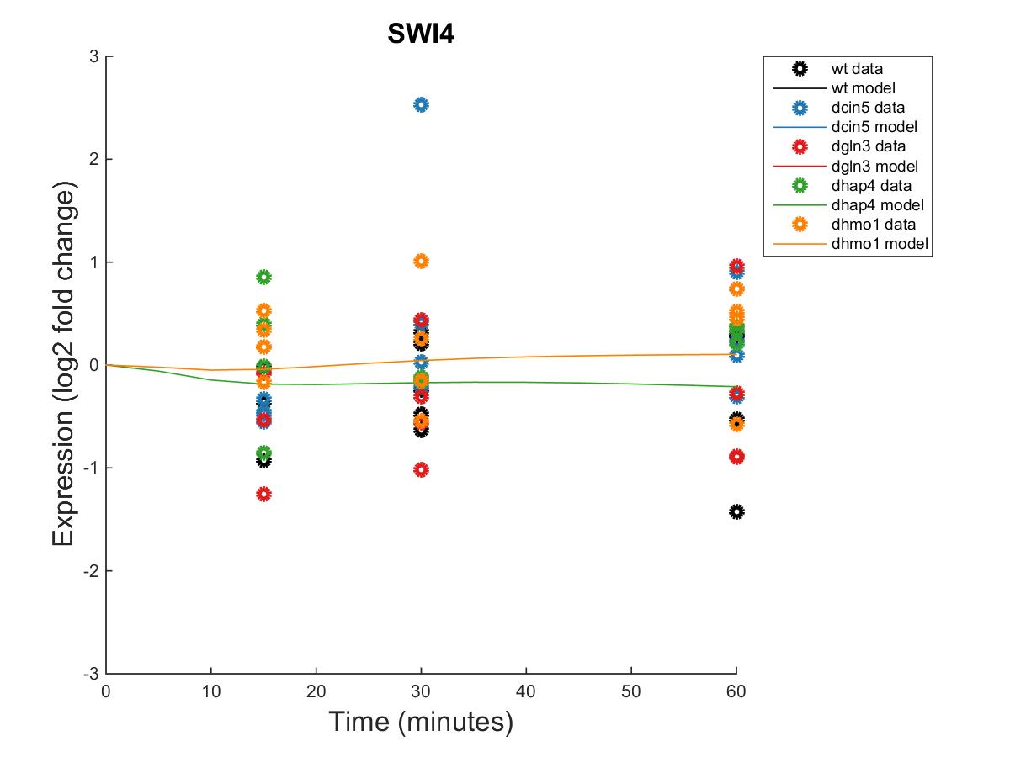
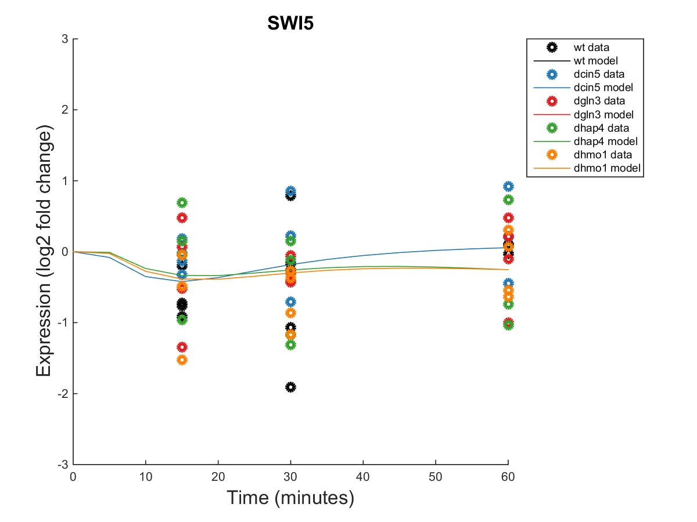
GRNmap Output Estimation of SFP1, STB5, SWI4, and SWI5
Within Strain ANOVA
0.4097
0.0494
0.0751
0.0533
0.8354
Within Strain ANOVA
0.3129
0.3692
0.3204
1.0193
0.4173
Within Strain ANOVA
0.6731
0.4839
0.3797
0.6155
0.9652
Within Strain ANOVA
0.0957
0.4463
0.3126
0.9868
0.5178
Notes:
Source: https://github.com/kdahlquist/DahlquistLab/blob/master/documents/NEW_BK_GRNmap_Testing_network_presentation-all-strains_20161030.pptx

Slide 22
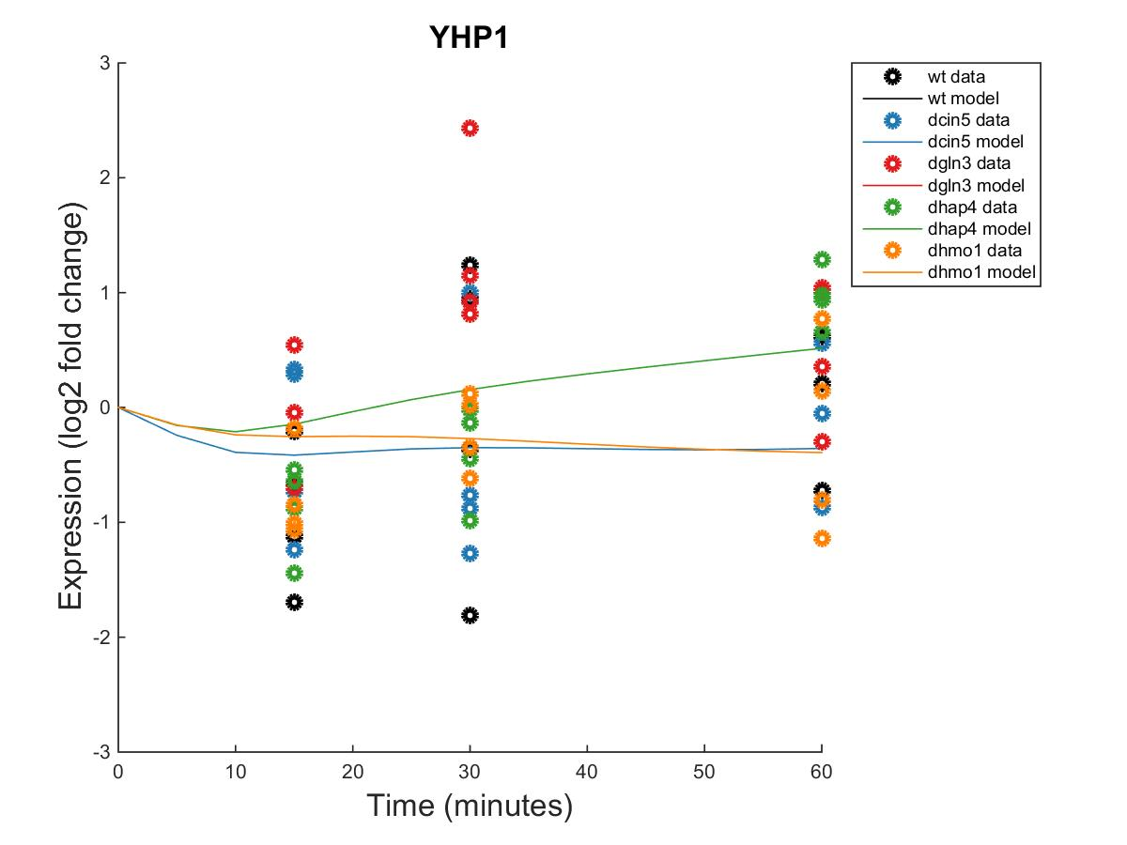
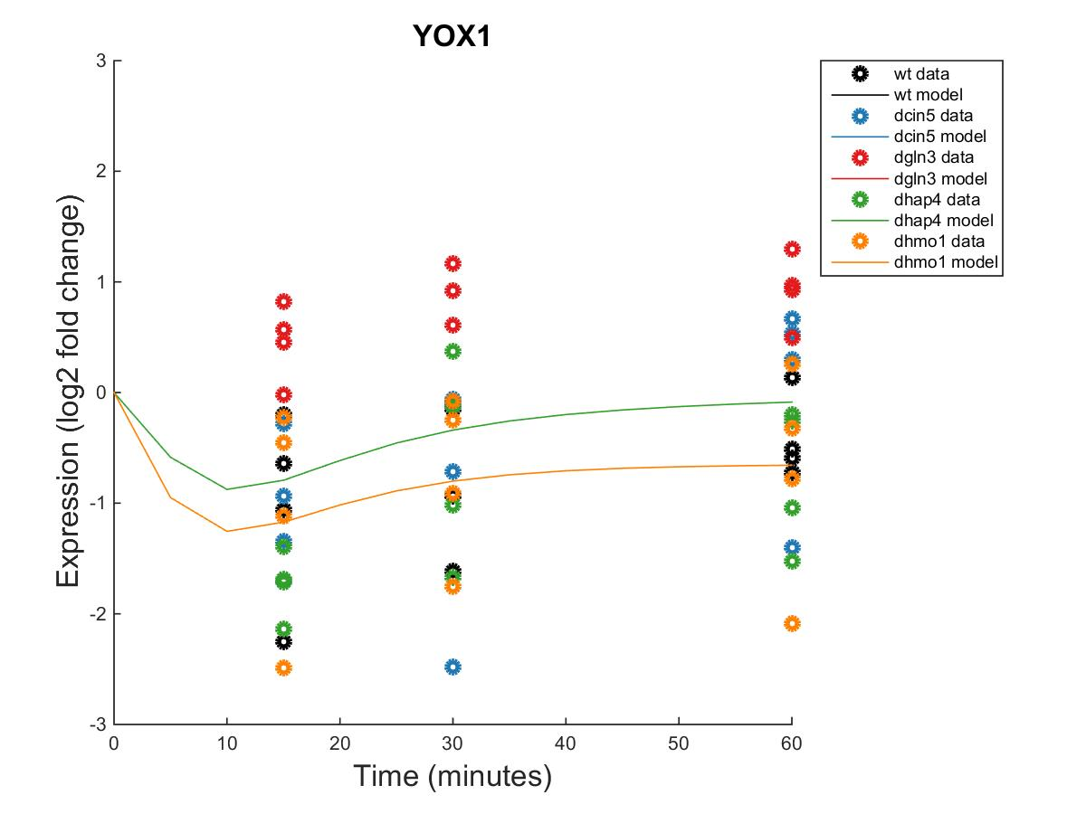
GRNmap Output Estimation of YHP1 and YOX1
Within Strain ANOVA
0.1743
0.8684
0.0433
0.0084
0.8152
Within Strain ANOVA
0.004
0.058
0.2181
0.0117
0.2197
Notes:
Source: https://github.com/kdahlquist/DahlquistLab/blob/master/documents/NEW_BK_GRNmap_Testing_network_presentation-all-strains_20161030.pptx

Slide 23
db2: Network Derived from ∆cin5 Data
14 Genes, 25 Edges
db2 appears to have more repression than activation of genes within the network.
Notes:
Source: https://github.com/kdahlquist/DahlquistLab/blob/master/documents/NEW_BK_GRNmap_Testing_network_presentation-all-strains_20161030.pptx

Slide 24
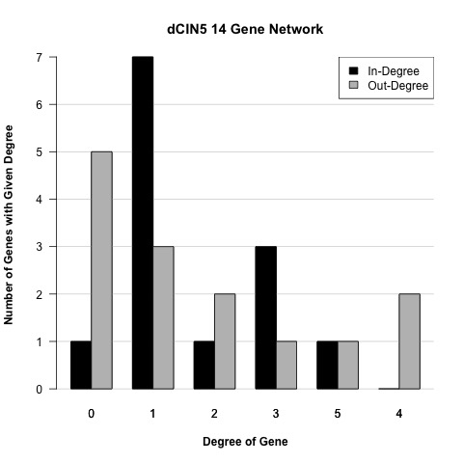
db2: Network Derived from ∆cin5 Data
14 Genes, 25 Edges
Notes:
Source: https://github.com/kdahlquist/DahlquistLab/blob/master/documents/NEW_BK_GRNmap_Testing_network_presentation-all-strains_20161030.pptx

Slide 25
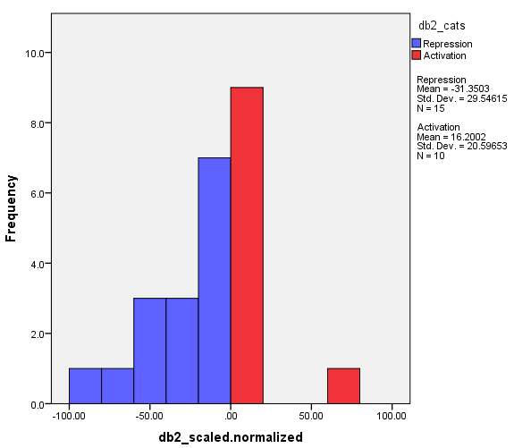
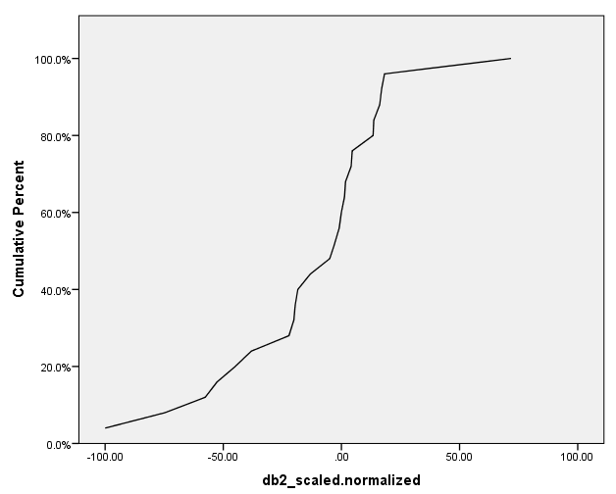
Distribution of db2 Regulatory Weights Network: 14 Genes, 25 Edges
Notes:
Source: https://github.com/kdahlquist/DahlquistLab/blob/master/documents/Weight-Distributions_Six-Networks_BK2017213.pptx
Issue: https://github.com/kdahlquist/GRNmap/issues/315

Slide 26
db2: Network Derived from ∆cin5 Data
14 Genes, 25 Edges
id | Optimized threshold_b | production_rate
CIN5 | -0.2500 | 1.5792
GCR2 | 0.2253 | 0.2253
GLN3 | 0.7220 | 0.4174
HAP4 | 2.1782 | 1.0796
HMO1 | 1.7324 | 0.5122
MGA2 | -0.0252 | 0.2725
MSN2 | -1.4075 | 2.1830
RDS3 | 1.0634 | 0.2958
SFP1 | -0.8488 | 1.4101
STB5 | 1.4014 | 0.6012
SWI4 | -0.5609 | 0.3355
SWI5 | -0.5153 | 1.1400
YHP1 | -1.8135 | 1.8826
YOX1 | -0.2274 | 1.3668
Notes:
Source: https://github.com/kdahlquist/DahlquistLab/blob/master/documents/NEW_BK_GRNmap_Testing_network_presentation-all-strains_20161030.pptx

Slide 27
db3: Network Derived from ∆cin5 Data
17 Genes, 32 Edges
Network Composed of the following genes:
ACE2
CIN5
GCR2
GLN3
HAP4
HMO1
MCM1
MGA2
MSN2
RDS3
SFP1
STB5
SWI4
SWI5
YHP1
YOX1
ZAP1
Notes:
Source: https://github.com/kdahlquist/DahlquistLab/blob/master/documents/NEW_BK_GRNmap_Testing_network_presentation-all-strains_20161030.pptx

Slide 28
db3: Network Derived from ∆cin5 Data
17 Genes, 32 Edges
Parameter | Value
Penalty Term | 1.7570
LSE | 0.7864
minLSE | 0.5449
LSE:minLSE ratio | 1.4100
Iteration Count | 118,921
Notes:
Source: https://github.com/kdahlquist/DahlquistLab/blob/master/documents/NEW_BK_GRNmap_Testing_network_presentation-all-strains_20161030.pptx

Slide 29
17-genes_32-edges_db3_Sigmoid_estimation_missing-values_L-curve
db3: Network Derived from ∆cin5 Data
17 Genes, 32 Edges
Notes:
Source: https://github.com/kdahlquist/DahlquistLab/blob/master/documents/L-Curve-Analysis_Varied-Optimization-Data-Size_BK20170909.pptx
Issue 1: https://github.com/kdahlquist/GRNmap/issues/351
Issue 2: https://github.com/kdahlquist/GRNmap/issues/360

Slide 30
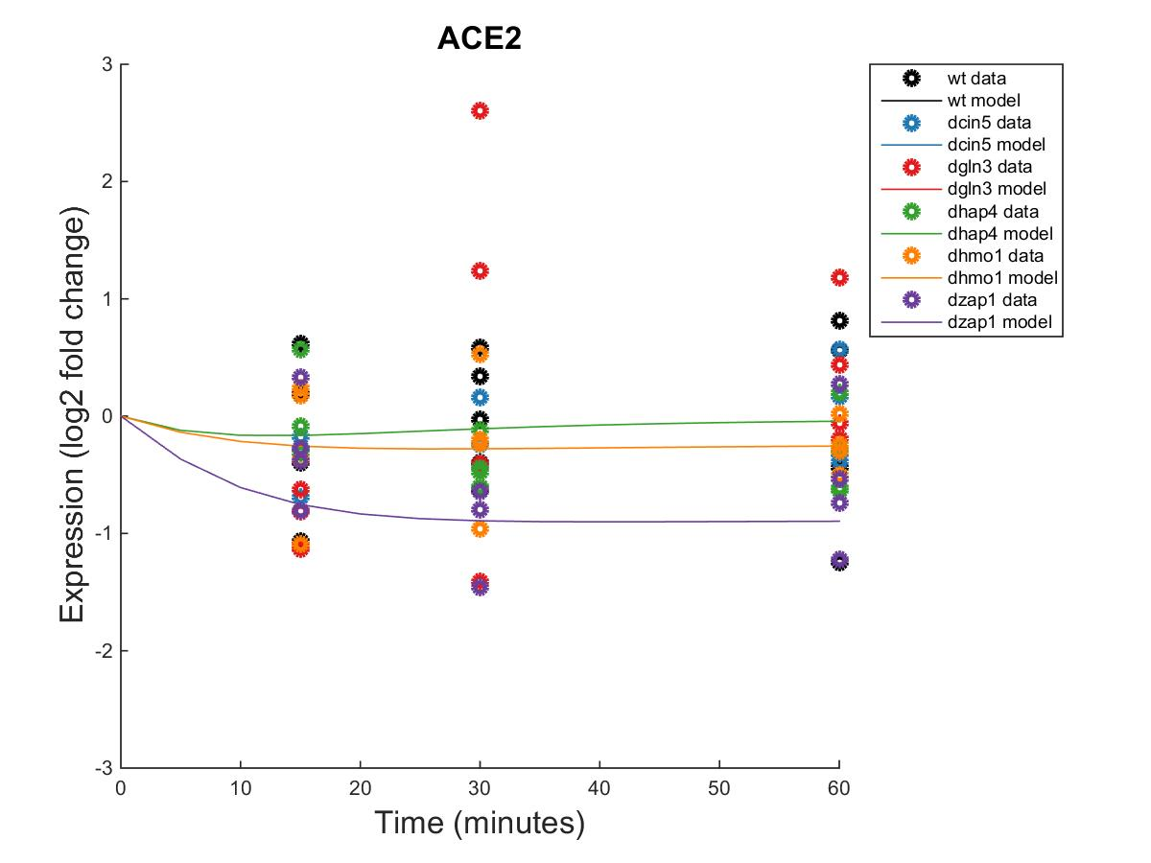



GRNmap Output Estimation of ACE2, CIN5, GCR2 and GLN3
Notes:
Source: https://github.com/kdahlquist/DahlquistLab/blob/master/documents/NEW_BK_GRNmap_Testing_network_presentation-all-strains_20161030.pptx

Slide 31




GRNmap Output Estimation of HAP4, HMO1, MCM1, and MGA2
Notes:
Source: https://github.com/kdahlquist/DahlquistLab/blob/master/documents/NEW_BK_GRNmap_Testing_network_presentation-all-strains_20161030.pptx

Slide 32




GRNmap Output Estimation of MSN2, RDS3, SFP1, and STB5
Notes:
Source: https://github.com/kdahlquist/DahlquistLab/blob/master/documents/NEW_BK_GRNmap_Testing_network_presentation-all-strains_20161030.pptx

Slide 33





GRNmap Output Estimation of SWI4, SWI5, YHP1, YOX1 and ZAP1
Notes:
Source: https://github.com/kdahlquist/DahlquistLab/blob/master/documents/NEW_BK_GRNmap_Testing_network_presentation-all-strains_20161030.pptx

Slide 34
db3: Network Derived from ∆cin5 Data
17 Genes, 32 Edges
db3 appears to have an equal distribution of high activation and repression.
Notes:
Source: https://github.com/kdahlquist/DahlquistLab/blob/master/documents/NEW_BK_GRNmap_Testing_network_presentation-all-strains_20161030.pptx

Slide 35


Distribution of db3 Regulatory Weights Network: 17 Genes, 32 Edges
Notes:
Source: https://github.com/kdahlquist/DahlquistLab/blob/master/documents/Weight-Distributions_Six-Networks_BK2017213.pptx
Issue: https://github.com/kdahlquist/GRNmap/issues/315

Slide 36

db3: Network Derived from ∆cin5 Data
17 Genes, 32 Edges
Notes:
Source: https://github.com/kdahlquist/DahlquistLab/blob/master/documents/NEW_BK_GRNmap_Testing_network_presentation-all-strains_20161030.pptx

Slide 37
db3: Network Derived from ∆cin5 Data
17 Genes, 32 Edges
id | Optimized threshold_b | production_rate
ACE2 | 1.4950 | 0.2233
CIN5 | 0.3752 | 0.8464
GCR2 | 0.2328 | 0.2328
GLN3 | 0.5978 | 0.2889
HAP4 | 3.1300 | 1.2711
HMO1 | 1.8877 | 0.5459
MCM1 | 0.2061 | 0.1443
MGA2 | -0.0327 | 0.2674
MSN2 | -1.8024 | 2.6109
RDS3 | 0.6593 | 0.1996
SFP1 | 0.7107 | 0.5865
STB5 | 0.1796 | 0.2471
SWI4 | -1.7389 | 0.2758
SWI5 | 0.1242 | 0.8183
YHP1 | 0.9109 | 0.7462
YOX1 | 0.0539 | 1.1141
ZAP1 | 0.1322 | 0.1322
Notes:
Source: https://github.com/kdahlquist/DahlquistLab/blob/master/documents/NEW_BK_GRNmap_Testing_network_presentation-all-strains_20161030.pptx

Slide 38
db4: Network Derived from ∆gln3 Data
14 Genes, 35 Edges
Network composed of the following genes:
CIN5
CYC8
GCR2
GLN3
HAP4
HMO1
MSN2
MSN4
SFP1
SWI4
SWI5
TEC1
YHP1
YOX1
Notes:
Source: https://github.com/kdahlquist/DahlquistLab/blob/master/documents/NEW_BK_GRNmap_Testing_network_presentation-all-strains_20161030.pptx

Slide 39
db4: Network Derived from ∆gln3 Data
14 Genes, 35 Edges
Parameter | Value
Penalty | 1.7895
LSE | 0.6994
min LSE | 0.5379
LSE/minLSE ratio | 1.3000
Iteration count | 78,124
Notes:
Source: https://github.com/kdahlquist/DahlquistLab/blob/master/documents/NEW_BK_GRNmap_Testing_network_presentation-all-strains_20161030.pptx

Slide 40
14-genes_35-edges_db4_Sigmoid_estimation_missing-values_L-curve
db4: Network Derived from ∆gln3 Data
14 Genes, 35 Edges
Notes:
Source: https://github.com/kdahlquist/DahlquistLab/blob/master/documents/L-Curve-Analysis_Varied-Optimization-Data-Size_BK20170909.pptx
Issue 1: https://github.com/kdahlquist/GRNmap/issues/351
Issue 2: https://github.com/kdahlquist/GRNmap/issues/360

Slide 41




GRNmap Output Estimation of CIN5, CYC8, GCR2, and GLN3
Within Strain ANOVA
0.0662
0.6188
0.0163
0.0112
0.4113
0.0260
Within Strain ANOVA
0.8043
0.0930
0.5305
0.0975
0.9353
0.9604
Within Strain ANOVA
0.3306
0.5876
0.8763
0.1261
0.8445
0.3479
Within Strain ANOVA
0.4189
0.5468
0.6094
0.5189
0.9281
0.1171
Notes:
Source: https://github.com/kdahlquist/DahlquistLab/blob/master/documents/NEW_BK_GRNmap_Testing_network_presentation-all-strains_20161030.pptx

Slide 42




GRNmap Output Estimation of HAP4, HMO1, MSN2, and MSN4
Within Strain ANOVA
0.7307
0.4821
0.0773
0.4165
0.9262
0.0157
Within Strain ANOVA
0.3056
0.2208
0.3427
0.0168
0.8021
0.0836
Within Strain ANOVA
0.0397
0.0022
0.0025
0.4244
0.5758
0.0011
Within Strain ANOVA
0.1887
0.1243
0.2398
0.0081
0.6214
0.0022
Notes:
Source: https://github.com/kdahlquist/DahlquistLab/blob/master/documents/NEW_BK_GRNmap_Testing_network_presentation-all-strains_20161030.pptx

Slide 43



GRNmap Output Estimation of SFP1, SWI4, and SWI5
Within Strain ANOVA
0.6731
0.4839
0.3797
0.6155
0.9652
0.7799
Within Strain ANOVA
0.4097
0.0494
0.0751
0.0533
0.8354
0.0021
Within Strain ANOVA
0.0957
0.4463
0.3126
0.9868
0.5178
0.2975
Notes:
Source: https://github.com/kdahlquist/DahlquistLab/blob/master/documents/NEW_BK_GRNmap_Testing_network_presentation-all-strains_20161030.pptx

Slide 44



GRNmap Output Estimation of TEC1, YHP1, and YOX1
Within Strain ANOVA
0.1743
0.8684
0.0433
0.0084
0.8152
0.0653
Within Strain ANOVA
0.0046
0.0078
0.0197
0.0654
0.2876
0.2627
Within Strain ANOVA
0.0040
0.0580
0.2181
0.0117
0.2197
0.2658
Notes:
Source: https://github.com/kdahlquist/DahlquistLab/blob/master/documents/NEW_BK_GRNmap_Testing_network_presentation-all-strains_20161030.pptx

Slide 45
db4: Network Derived from ∆gln3 Data
14 Genes, 35 Edges
db4 appears to exhibit similar levels of activation and repression of genes within the network.
Notes:
Source: https://github.com/kdahlquist/DahlquistLab/blob/master/documents/NEW_BK_GRNmap_Testing_network_presentation-all-strains_20161030.pptx

Slide 46


Distribution of db4 Regulatory Weights Network: 14 Genes, 35 Edges
Notes:
Source: https://github.com/kdahlquist/DahlquistLab/blob/master/documents/Weight-Distributions_Six-Networks_BK2017213.pptx
Issue: https://github.com/kdahlquist/GRNmap/issues/315

Slide 47

db4: Network Derived from ∆gln3 Data
14 Genes, 35 Edges
Notes:
Source: https://github.com/kdahlquist/DahlquistLab/blob/master/documents/NEW_BK_GRNmap_Testing_network_presentation-all-strains_20161030.pptx

Slide 48
db4: Network Derived from ∆gln3 Data
14 Genes, 35 Edges
id | Optimized production_rate | threshold_b
CIN5 | 1.2710 | 0.2094
CYC8 | 0.1608 | 0.9504
GCR2 | 0.2204 | 0.2204
GLN3 | 0.2845 | 1.4824
HAP4 | 1.2569 | 0.6142
HMO1 | 0.1829 | 0.8709
MSN2 | 0.5202 | 1.6614
MSN4 | 1.3203 | -0.0135
SFP1 | 1.1973 | -0.0214
SWI4 | 0.2878 | 0.7661
SWI5 | 2.3058 | -2.5539
TEC1 | 1.5765 | 0.3510
YHP1 | 0.5388 | 1.1083
YOX1 | 0.7925 | 1.6923
Notes:
Source: https://github.com/kdahlquist/DahlquistLab/blob/master/documents/NEW_BK_GRNmap_Testing_network_presentation-all-strains_20161030.pptx

Slide 49
db5: Network Derived from ∆hap4 Data
15 Genes, 28 Edges
Network composed of the following genes:
ACE2
ASH1
CIN5
GCR2
GLN3
HAP4
HMO1
MSN2
SFP1
STB5
SWI4
SWI5
YHP1
YOX1
ZAP1
Notes:
Source: https://github.com/kdahlquist/DahlquistLab/blob/master/documents/NEW_BK_GRNmap_Testing_network_presentation-all-strains_20161030.pptx

Slide 50
db5: Network Derived from ∆hap4 Data
15 Genes, 28 Edges
Parameter | Value
Penalty | 2.3443
LSE | 0.6919
min LSE | 0.4851
LSE/minLSE ratio | 1.4263
Iteration count | 62,139
Notes:
Source: https://github.com/kdahlquist/DahlquistLab/blob/master/documents/NEW_BK_GRNmap_Testing_network_presentation-all-strains_20161030.pptx

Slide 51
15-genes_28-edges_db5_Sigmoid_estimation_missing-values_L-curve
db5: Network Derived from ∆hap4 Data
15 Genes, 28 Edges
Notes:
Source: https://github.com/kdahlquist/DahlquistLab/blob/master/documents/L-Curve-Analysis_Varied-Optimization-Data-Size_BK20170909.pptx
Issue 1: https://github.com/kdahlquist/GRNmap/issues/351
Issue 2: https://github.com/kdahlquist/GRNmap/issues/360

Slide 52




GRNmap Output Estimation of ACE2, ASH1, CIN5, and GCR2
Within Strain ANOVA
0.7624
0.4462
0.7855
0.2916
0.8258
0.0457
Within Strain ANOVA
0.0829
0.0091
0.5202
0.0723
0.7639
0.4535
Within Strain ANOVA
0.0662
0.6188
0.0163
0.0112
0.4113
0.026
Within Strain ANOVA
0.3306
0.5876
0.8763
0.1261
0.8445
0.3479
Notes:
Source: https://github.com/kdahlquist/DahlquistLab/blob/master/documents/NEW_BK_GRNmap_Testing_network_presentation-all-strains_20161030.pptx

Slide 53




GRNmap Output Estimation of GLN3, HAP4, HMO1, and MSN2
Within Strain ANOVA
0.4189
0.5468
0.6094
0.5189
0.9281
0.1171
Within Strain ANOVA
0.7307
0.4821
0.0773
0.4165
0.9262
0.0157
Within Strain ANOVA
0.0397
0.0022
0.0025
0.4244
0.5758
0.0011
Within Strain ANOVA
0.3056
0.2208
0.3427
0.0168
0.8021
0.0836
Notes:
Source: https://github.com/kdahlquist/DahlquistLab/blob/master/documents/NEW_BK_GRNmap_Testing_network_presentation-all-strains_20161030.pptx

Slide 54




GRNmap Output Estimation of SFP1, STB5, SWI4, and SWI5
Within Strain ANOVA
0.4097
0.0494
0.0751
0.0533
0.8354
0.0021
Within Strain ANOVA
0.3129
0.3692
0.3204
1.0193
0.4173
0.3296
Within Strain ANOVA
0.6731
0.4839
0.3797
0.6155
0.9652
0.7799
Within Strain ANOVA
0.0957
0.4463
0.3126
0.9868
0.5178
0.2975
Notes:
Source: https://github.com/kdahlquist/DahlquistLab/blob/master/documents/NEW_BK_GRNmap_Testing_network_presentation-all-strains_20161030.pptx

Slide 55



GRNmap Output Estimation of YHP1, YOX1, and ZAP1
Within Strain ANOVA
0.1743
0.8684
0.0433
0.0084
0.8152
0.0653
Within Strain ANOVA
0.0089
0.316
0.2503
1.0134
0.8824
0.4562
Within Strain ANOVA
0.004
0.058
0.2181
0.0117
0.2197
0.2658
Notes:
Source: https://github.com/kdahlquist/DahlquistLab/blob/master/documents/NEW_BK_GRNmap_Testing_network_presentation-all-strains_20161030.pptx

Slide 56

db5: Network Derived from ∆hap4 Data
15 Genes, 28 Edges
Notes:
Source: https://github.com/kdahlquist/DahlquistLab/blob/master/documents/NEW_BK_GRNmap_Testing_network_presentation-all-strains_20161030.pptx

Slide 57
db5: Network Derived from ∆hap4 Data
15 Genes, 28 Edges
db5 appears to have a similar distribution of activation and repression of genes in the network.
Notes:
Source: https://github.com/kdahlquist/DahlquistLab/blob/master/documents/NEW_BK_GRNmap_Testing_network_presentation-all-strains_20161030.pptx

Slide 58


Distribution of db5 Regulatory Weights Network: 15 Genes, 28 Edges
Notes:
Source: https://github.com/kdahlquist/DahlquistLab/blob/master/documents/Weight-Distributions_Six-Networks_BK2017213.pptx
Issue: https://github.com/kdahlquist/GRNmap/issues/315

Slide 59
db5: Network Derived from ∆hap4 Data
15 Genes, 28 Edges
id | Optimized production_rate | threshold_b
ACE2 | 0.1632 | 0.6002
ASH1 | 2.0268 | -1.7884
CIN5 | 0.9511 | 2.3690
GCR2 | 0.2351 | 0.2351
GLN3 | 0.2878 | 0.8206
HAP4 | 1.6726 | 0.7266
HMO1 | 0.2387 | 0.9680
MSN2 | 0.8824 | 4.7489
SFP1 | 1.2094 | 1.0399
STB5 | 0.3204 | 0.5771
SWI4 | 0.2412 | 0.3262
SWI5 | 1.2497 | -0.5910
YHP1 | 0.3411 | 2.3043
YOX1 | 0.8646 | 2.0954
ZAP1 | 0.1298 | 0.1298
Notes:
Source: https://github.com/kdahlquist/DahlquistLab/blob/master/documents/NEW_BK_GRNmap_Testing_network_presentation-all-strains_20161030.pptx

Slide 60
db6: Network Derived from ∆zap1 Data
16 Genes, 27 Edges
Network composed of the following genes:
ABF1
ACE2
CIN5
CST6
GCN4
GCR2
GLN3
HAP4
HMO1
HSF1
MCM1
MGA2
MSN2
MSN4
SWI4
ZAP1
Notes:
Source: https://github.com/kdahlquist/DahlquistLab/blob/master/documents/NEW_BK_GRNmap_Testing_network_presentation-all-strains_20161030.pptx

Slide 61
db6: Network Derived from ∆zap1 Data
16 Genes, 27 Edges
Parameter | Value
Penalty | 1.8276
LSE | 0.8602
min LSE | 0.6156
LSE/minLSE ratio | 1.3973
Iteration count | 76,769
Notes:
Source: https://github.com/kdahlquist/DahlquistLab/blob/master/documents/NEW_BK_GRNmap_Testing_network_presentation-all-strains_20161030.pptx

Slide 62
16-genes_27-edges_db6_Sigmoid_estimation_missing-values_L-curve
db6: Network Derived from ∆zap1 Data
16 Genes, 27 Edges
Notes:
Source: https://github.com/kdahlquist/DahlquistLab/blob/master/documents/L-Curve-Analysis_Varied-Optimization-Data-Size_BK20170909.pptx
Issue 1: https://github.com/kdahlquist/GRNmap/issues/351
Issue 2: https://github.com/kdahlquist/GRNmap/issues/360

Slide 63




GRNmap Output Estimation of ABF1, ACE2, CIN5, and CST6
Within Strain ANOVA
0.0055
0.0148
0.1095
0.0004
0.5993
0.0895
Within Strain ANOVA
0.7624
0.4462
0.7855
0.2916
0.8258
0.0457
Within Strain ANOVA
0.0662
0.6188
0.0163
0.0112
0.4113
0.026
Within Strain ANOVA
0.0005
0.5571
0.3191
0.3863
0.4009
0.0376
Notes:
Source: https://github.com/kdahlquist/DahlquistLab/blob/master/documents/NEW_BK_GRNmap_Testing_network_presentation-all-strains_20161030.pptx

Slide 64




GRNmap Output Estimation of GCN4, GCR2, GLN3, and HAP4
Within Strain ANOVA
0.6297
0.2761
0.2751
0.5058
0.9118
0.5207
Within Strain ANOVA
0.3306
0.5876
0.8763
0.1261
0.8445
0.3479
Within Strain ANOVA
0.4189
0.5468
0.6094
0.5189
0.9281
0.1171
Within Strain ANOVA
0.7307
0.4821
0.0773
0.4165
0.9262
0.0157
Notes:
Source: https://github.com/kdahlquist/DahlquistLab/blob/master/documents/NEW_BK_GRNmap_Testing_network_presentation-all-strains_20161030.pptx

Slide 65




GRNmap Output Estimation of HMO1, HSF1, MCM1, and MGA2
Within Strain ANOVA
0.0397
0.0022
0.0025
0.4244
0.5758
0.0011
Within Strain ANOVA
0.1345
0.0295
0.0488
0.015
0.5281
0.0159
Within Strain ANOVA
0.9354
0.093
0.8677
0.1031
0.9311
0.9415
Within Strain ANOVA
0.0996
0.3003
0.4415
0.3822
0.4679
0.5113
Notes:
Source: https://github.com/kdahlquist/DahlquistLab/blob/master/documents/NEW_BK_GRNmap_Testing_network_presentation-all-strains_20161030.pptx

Slide 66




GRNmap Output Estimation of MSN2, MSN4, SWI4, and ZAP1
Within Strain ANOVA
0.3056
0.2208
0.3427
0.0168
0.8021
0.0836
Within Strain ANOVA
0.1887
0.1243
0.2398
0.0081
0.6214
0.0022
Within Strain ANOVA
0.6731
0.4839
0.3797
0.6155
0.9652
0.7799
Within Strain ANOVA
0.0089
0.316
0.2503
1.0134
0.8824
0.4562
Notes:
Source: https://github.com/kdahlquist/DahlquistLab/blob/master/documents/NEW_BK_GRNmap_Testing_network_presentation-all-strains_20161030.pptx

Slide 67
db6: Network Derived from ∆zap1 Data
16 Genes, 27 Edges
db6 appears to have more repression than activation of genes within the network.
Notes:
Source: https://github.com/kdahlquist/DahlquistLab/blob/master/documents/NEW_BK_GRNmap_Testing_network_presentation-all-strains_20161030.pptx

Slide 68

db6: Network Derived from ∆zap1 Data
16 Genes, 27 Edges
Notes:
Source: https://github.com/kdahlquist/DahlquistLab/blob/master/documents/NEW_BK_GRNmap_Testing_network_presentation-all-strains_20161030.pptx

Slide 69


Distribution of db6 Regulatory Weights Network: 16 Genes, 27 Edges
Notes:
Source: https://github.com/kdahlquist/DahlquistLab/blob/master/documents/Weight-Distributions_Six-Networks_BK2017213.pptx
Issue: https://github.com/kdahlquist/GRNmap/issues/315

Slide 70
db6: Network Derived from ∆zap1 Data
16 Genes, 27 Edges
id | Optimized production_rate | threshold_b
ABF1 | 0.0576 | 0.0576
ACE2 | 0.2315 | 1.5390
CIN5 | 1.9157 | -0.5369
CST6 | 0.2917 | -0.0235
GCN4 | 0.0456 | -0.9424
GCR2 | 0.2278 | 0.2278
GLN3 | 1.3572 | -0.4477
HAP4 | 1.7046 | 0.1702
HMO1 | 0.2390 | 0.3849
HSF1 | 0.1079 | 0.0950
MCM1 | 0.1429 | 0.2643
MGA2 | 0.3076 | -0.0397
MSN2 | 1.3539 | -0.6478
MSN4 | 1.4054 | 1.7175
SWI4 | 0.2128 | -2.7446
ZAP1 | 0.1307 | 0.1307
Notes:
Source: https://github.com/kdahlquist/DahlquistLab/blob/master/documents/NEW_BK_GRNmap_Testing_network_presentation-all-strains_20161030.pptx

Slide 71
L-Curve Comparison of db1-db6
Notes:
Source: https://github.com/kdahlquist/DahlquistLab/blob/master/documents/L-Curve-Analysis_Varied-Optimization-Data-Size_BK20170909.pptx
Issue 1: https://github.com/kdahlquist/GRNmap/issues/351
Issue 2: https://github.com/kdahlquist/GRNmap/issues/360

Slide 72
Notes:
Source: https://github.com/kdahlquist/DahlquistLab/blob/master/documents/Five-Networks_Bar-Chart-Analysis_BK20161116.pptx
Original Note: GCR2, ZAP1, & others have relatively consistent production rates. Can we compare these estimates to published values?

Slide 73
Notes:
Source: https://github.com/kdahlquist/DahlquistLab/blob/master/documents/Five-Networks_Bar-Chart-Analysis_BK20161116.pptx
Issue: https://github.com/kdahlquist/GRNmap/issues/274

Slide 74
Notes:
Source: https://github.com/kdahlquist/DahlquistLab/blob/master/documents/Five-Networks_Bar-Chart-Analysis_BK20161116.pptx
Issue: https://github.com/kdahlquist/GRNmap/issues/274

Slide 75
Notes:
Source: https://github.com/kdahlquist/DahlquistLab/blob/master/documents/Five-Networks_Bar-Chart-Analysis_BK20161116.pptx
Issue: https://github.com/kdahlquist/GRNmap/issues/274

Slide 76
Notes:
Source: https://github.com/kdahlquist/DahlquistLab/blob/master/documents/Five-Networks_Bar-Chart-Analysis_BK20161116.pptx
Issue: https://github.com/kdahlquist/GRNmap/issues/274

Slide 77
Notes:
Source: https://github.com/kdahlquist/DahlquistLab/blob/master/documents/Five-Networks_Bar-Chart-Analysis_BK20161116.pptx
Issue: https://github.com/kdahlquist/GRNmap/issues/274

Slide 78
Notes:
Source: https://github.com/kdahlquist/DahlquistLab/blob/master/documents/Five-Networks_Bar-Chart-Analysis_BK20161116.pptx
Issue: https://github.com/kdahlquist/GRNmap/issues/274

Slide 79
Notes:
Source: https://github.com/kdahlquist/DahlquistLab/blob/master/documents/Five-Networks_Bar-Chart-Analysis_BK20161116.pptx
Issue: https://github.com/kdahlquist/GRNmap/issues/274

Slide 80
Notes:
Source: https://github.com/kdahlquist/DahlquistLab/blob/master/data/Spring2017/15-gene_networks_analysis/Graph-Statistics-Comparison_BK20170315.pptx
When present, GCN4 has eigenvector centrality of 1.

Slide 81
Notes:
Source: https://github.com/kdahlquist/DahlquistLab/blob/master/data/Spring2017/15-gene_networks_analysis/Graph-Statistics-Comparison_BK20170315.pptx

Slide 82
Notes:
Source: https://github.com/kdahlquist/DahlquistLab/blob/master/data/Spring2017/15-gene_networks_analysis/Graph-Statistics-Comparison_BK20170315.pptx

Slide 83
Notes:
Source: https://github.com/kdahlquist/DahlquistLab/blob/master/data/Spring2017/15-gene_networks_analysis/Graph-Statistics-Comparison_BK20170315.pptx

Slide 84
Notes:
Source: https://github.com/kdahlquist/DahlquistLab/blob/master/data/Spring2017/15-gene_networks_analysis/Graph-Statistics-Comparison_BK20170315.pptx

Slide 85
Edge Weight Statistics for db1-db6
 | db1 | db2 | db3 | db4 | db5 | db6
Activation: | 19 | 6 | 18 | 16 | 14 | 13
Repression: | 7 | 11 | 10 | 12 | 10 | 11
Small Influence (SI): | 10 | 8 | 4 | 7 | 4 | 3
Total Edges: | 36 | 25 | 32 | 35 | 28 | 27
SUM: | 8.1432 | -13.2390 | 1.5688 | -2.5750 | 1.2985 | -5.8876
SUM(abs): | 38.8426 | 27.1541 | 36.1524 | 36.9479 | 34.2000 | 33.0703
MAX: | 5.9424 | 3.0815 | 3.1810 | 2.4940 | 3.2167 | 3.7631
MIN: | -3.3601 | -4.2947 | -3.6707 | -4.0281 | -4.0374 | -3.5141
MAX(abs): | 5.9424 | 4.2947 | 3.6707 | 4.0281 | 4.0374 | 3.7631
SI Threshold: | 0.2971 | 0.2147 | 0.1835 | 0.2014 | 0.2019 | 0.1882
MEAN: | 0.2262 | -0.5296 | 0.0490 | -0.0736 | 0.0464 | -0.2181
STDEV: | 1.6215 | 1.5085 | 1.5597 | 1.5026 | 1.6433 | 1.6812
MEDIAN: | 0.3310 | -0.1214 | 0.2323 | 0.1139 | 0.2144 | 0.1276
Notes:
Source: https://github.com/kdahlquist/DahlquistLab/blob/master/data/Spring2017/15-gene_networks_analysis/Regulatory-Relationships_Six-Networks_BK20170313.xlsx
Issue: https://github.com/kdahlquist/GRNmap/issues/315

Slide 86
Heat Map Comparing Edge Weights in db1-db6
 | db1 | db2 | db3 | db4 | db5 | db6 |  | db1 | db2 | db3 | db4 | db5 | db6
ABF1->ASF1 |  |  |  |  |  |  | MCM1->SWI4
ABF1->ASH1 |  |  |  |  |  |  | MCM1->SWI5
ABF1->CST6 |  |  |  |  |  |  | MCM1->YHP1
ABF1->HMO1 |  |  |  |  |  |  | MCM1->YOX1
ABF1->MGA2 |  |  |  |  |  |  | MSN2->AFT2
ABF1->MSN4 |  |  |  |  |  |  | MSN2->ASF1
ABF1->SFP1 |  |  |  |  |  |  | MSN2->ASH1
ABF1->SWI4 |  |  |  |  |  |  | MSN2->CIN5
ACE2->ASH1 |  |  |  |  |  |  | MSN2->CYC8
ASH1->YHP1 |  |  |  |  |  |  | MSN2->HAP4
CIN5->ASF1 |  |  |  |  |  |  | MSN2->MSN4
CIN5->CYC8 |  |  |  |  |  |  | MSN2->SFP1
CIN5->HAP4 |  |  |  |  |  |  | MSN2->SWI4
CIN5->SFP1 |  |  |  |  |  |  | MSN2->TEC1
CIN5->STB5 |  |  |  |  |  |  | MSN2->YHP1
CIN5->TEC1 |  |  |  |  |  |  | MSN2->YOX1
CIN5->YHP1 |  |  |  |  |  |  | SFP1->SWI5
GCN4->GLN3 |  |  |  |  |  |  | STB5->HAP4
GLN3->GCN4 |  |  |  |  |  |  | STB5->SFP1
GLN3->MGA2 |  |  |  |  |  |  | SWI4->CYC8
GRC2->MSN2 |  |  |  |  |  |  | SWI4->HAP4
HAP4->GCN4 |  |  |  |  |  |  | SWI4->YHP1
HMO1->ASF1 |  |  |  |  |  |  | SWI4->YOX1
HMO1->CIN5 |  |  |  |  |  |  | SWI5->ASH1
HMO1->CYC8 |  |  |  |  |  |  | SWI5->TEC1
HMO1->GCN4 |  |  |  |  |  |  | TEC1->CIN5
HMO1->HAP4 |  |  |  |  |  |  | TEC1->HAP4
HMO1->HMO1 |  |  |  |  |  |  | TEC1->MSN2
HMO1->HSF1 |  |  |  |  |  |  | TEC1->SFP1
HMO1->MCM1 |  |  |  |  |  |  | TEC1->YHP1
HMO1->MSN2 |  |  |  |  |  |  | YHP1->ASF1
HMO1->MSN4 |  |  |  |  |  |  | YHP1->GLN3
HMO1->TEC1 |  |  |  |  |  |  | YHP1->RDS3
HMO1->YOX1 |  |  |  |  |  |  | ZAP1->ACE2
MCM1->ACE2
Maximum: 1
Minimum : -1
Notes:
Source: https://github.com/kdahlquist/DahlquistLab/blob/master/data/Spring2017/15-gene_networks_analysis/Regulatory-Relationships_Six-Networks_BK20170313.xlsx
Issue: https://github.com/kdahlquist/GRNmap/issues/315
Motif from poster: HMO1 → CIN5 → YHP1 → GLN3

Slide 87
Overview of Figures Organized by Significant P values
Natalie Williams
Notes:
Source: https://github.com/kdahlquist/DahlquistLab/blob/master/data/Spring2017/15-gene_networks_analysis/Expression-plots_db1-6_Organized-by-Significant-Pvalues.pptx

Slide 88







Db network 1 expression plots of genes with significant p-values for 2 or more strains
Notes:
Source: https://github.com/kdahlquist/DahlquistLab/blob/master/data/Spring2017/15-gene_networks_analysis/Expression-plots_db1-6_Organized-by-Significant-Pvalues.pptx

Slide 89






Db network 1 expression plots for genes with one significant p-value for across all strains
Notes:
Source: https://github.com/kdahlquist/DahlquistLab/blob/master/data/Spring2017/15-gene_networks_analysis/Expression-plots_db1-6_Organized-by-Significant-Pvalues.pptx

Slide 90
Expression plots of genes in Db network 1 with no significant p-values for their expression levels
Notes:
Source: https://github.com/kdahlquist/DahlquistLab/blob/master/data/Spring2017/15-gene_networks_analysis/Expression-plots_db1-6_Organized-by-Significant-Pvalues.pptx

Slide 91





Db network 2 (derived 17-gene network from dcin5 data) expression plots of genes with significant p values across 2 or more strains
Notes:
Source: https://github.com/kdahlquist/DahlquistLab/blob/master/data/Spring2017/15-gene_networks_analysis/Expression-plots_db1-6_Organized-by-Significant-Pvalues.pptx

Slide 92
Db network 2 expression plots of genes with one significant p-value for a specific strain
Notes:
Source: https://github.com/kdahlquist/DahlquistLab/blob/master/data/Spring2017/15-gene_networks_analysis/Expression-plots_db1-6_Organized-by-Significant-Pvalues.pptx

Slide 93








Db network 2 expression plots of genes with no significant p values across all strains.
Notes:
Source: https://github.com/kdahlquist/DahlquistLab/blob/master/data/Spring2017/15-gene_networks_analysis/Expression-plots_db1-6_Organized-by-Significant-Pvalues.pptx

Slide 94
Db network 4 expression plots of genes with significant p-values for 2 or more strains.
Notes:
Source: https://github.com/kdahlquist/DahlquistLab/blob/master/data/Spring2017/15-gene_networks_analysis/Expression-plots_db1-6_Organized-by-Significant-Pvalues.pptx

Slide 95

Db network 4 expression plots of genes with one significant p value across all strains.
Notes:
Source: https://github.com/kdahlquist/DahlquistLab/blob/master/data/Spring2017/15-gene_networks_analysis/Expression-plots_db1-6_Organized-by-Significant-Pvalues.pptx

Slide 96






Db network 4 expression plots of genes with no significant p values across all strains.
Notes:
Source: https://github.com/kdahlquist/DahlquistLab/blob/master/data/Spring2017/15-gene_networks_analysis/Expression-plots_db1-6_Organized-by-Significant-Pvalues.pptx

Slide 97





Db network 5 expression plots of genes with significant p values for 2 or more strains.
Notes:
Source: https://github.com/kdahlquist/DahlquistLab/blob/master/data/Spring2017/15-gene_networks_analysis/Expression-plots_db1-6_Organized-by-Significant-Pvalues.pptx

Slide 98





Db network 5 expression plots of genes with one significant p value across all strains.
Notes:
Source: https://github.com/kdahlquist/DahlquistLab/blob/master/data/Spring2017/15-gene_networks_analysis/Expression-plots_db1-6_Organized-by-Significant-Pvalues.pptx

Slide 99




Db network 5 expression plots of genes with no significant p values for any of the strains.
Notes:
Source: https://github.com/kdahlquist/DahlquistLab/blob/master/data/Spring2017/15-gene_networks_analysis/Expression-plots_db1-6_Organized-by-Significant-Pvalues.pptx

Slide 100






Db network 6 expression plots of genes with significant p values for 2 or more strains.
Notes:
Source: https://github.com/kdahlquist/DahlquistLab/blob/master/data/Spring2017/15-gene_networks_analysis/Expression-plots_db1-6_Organized-by-Significant-Pvalues.pptx

Slide 101




Db network 6 expression plots for genes with one significant p value across all strains.
Notes:
Source: https://github.com/kdahlquist/DahlquistLab/blob/master/data/Spring2017/15-gene_networks_analysis/Expression-plots_db1-6_Organized-by-Significant-Pvalues.pptx

Slide 102






Db network 6 expression plots of genes with no significant p values for all strains
Notes:
Source: https://github.com/kdahlquist/DahlquistLab/blob/master/data/Spring2017/15-gene_networks_analysis/Expression-plots_db1-6_Organized-by-Significant-Pvalues.pptx

Slide 103
Identifying Determinants of MSE in db1
Notes:
Source: https://github.com/kdahlquist/DahlquistLab/blob/master/documents/db1-Multiple-Regression_BK20170220.pptx
Issue: https://github.com/kdahlquist/GRNmap/issues/330

Slide 104


db1: Collinearity Assessment
Notes:
Source: https://github.com/kdahlquist/DahlquistLab/blob/master/documents/db1-Multiple-Regression_BK20170220.pptx
Issue: https://github.com/kdahlquist/GRNmap/issues/330

Slide 105

Eccentricity
Clustering
Eigencentrality
Notes:
Source: https://github.com/kdahlquist/DahlquistLab/blob/master/documents/db1-Multiple-Regression_BK20170220.pptx
Issue: https://github.com/kdahlquist/GRNmap/issues/330

Slide 106


db1: Final Model
Preliminary Conclusions:
~50% of the variance in how well the model fit expression data for each TF (MSE) could be explained via d, optimized p, in degree, & closeness centrality
Better fit achieved when:
In degree is high
Closeness centrality is high
Degradation rate is high
Optimized production rate is low
Cooperative Effect (?)—Reg. by several indep. motifs
Both favor low [Transcription Factor]. Why?
Notes:
Source: https://github.com/kdahlquist/DahlquistLab/blob/master/documents/db1-Multiple-Regression_BK20170220.pptx
Issue: https://github.com/kdahlquist/GRNmap/issues/330

Slide 107
Identifying Determinants of Node MSE:minMSE Ratios in db1-db6
Notes:
Source: https://github.com/kdahlquist/DahlquistLab/blob/master/data/Spring2017/15-gene_networks_analysis/multiple_regression_analysis/db1-db6_Multiple-Regression_BK20170329.pptx
Issue: https://github.com/kdahlquist/GRNmap/issues/330

Slide 108
Notes:
Source: https://github.com/kdahlquist/DahlquistLab/blob/master/data/Spring2017/15-gene_networks_analysis/multiple_regression_analysis/db1-db6_Multiple-Regression_BK20170329.pptx
Issue: https://github.com/kdahlquist/GRNmap/issues/330
(clustering is colinear w/ in–degree)

Slide 109
Comparison of db5 to Random Networks with the Same Number of Nodes and Edges Natalie Williams
Notes:
Source: https://github.com/kdahlquist/GRNmap/blob/master/documents/presentations/LMUURS17_NEW.pptx

Slide 110
Notes:
Source: https://github.com/kdahlquist/GRNmap/blob/master/documents/presentations/LMUURS17_NEW.pptx
Issue: https://github.com/kdahlquist/GRNmap/issues/301

Slide 111
A database-derived network (db5) was modeled better in comparison to random networks, providing evidence that the network explains the biological response to cold shock.
Notes:
Source: https://github.com/kdahlquist/GRNmap/blob/master/documents/presentations/LMUURS17_NEW.pptx
Issue: https://github.com/kdahlquist/GRNmap/issues/301

Slide 112
db5 vs. 3 Best Random Networks
Notes:
Source: https://github.com/kdahlquist/DahlquistLab/blob/master/documents/L-Curve-Analysis_Varied-Optimization-Data-Size_BK20170909.pptx
Issue 1: https://github.com/kdahlquist/GRNmap/issues/351
Issue 2: https://github.com/kdahlquist/GRNmap/issues/360

Slide 113
db5 vs. 3 Middle Random Networks
Notes:
Source: https://github.com/kdahlquist/DahlquistLab/blob/master/documents/L-Curve-Analysis_Varied-Optimization-Data-Size_BK20170909.pptx
Issue 1: https://github.com/kdahlquist/GRNmap/issues/351
Issue 2: https://github.com/kdahlquist/GRNmap/issues/360

Slide 114
db5 vs. 3 Middle + 3 Best Random Networks
Notes:
Source: https://github.com/kdahlquist/DahlquistLab/blob/master/documents/L-Curve-Analysis_Varied-Optimization-Data-Size_BK20170909.pptx
Issue 1: https://github.com/kdahlquist/GRNmap/issues/351
Issue 2: https://github.com/kdahlquist/GRNmap/issues/360
3 Middle: rand2, rand3, rand9
3 Best: rand15, rand16, rand24
Interesting Note: Dynamics of rand 2 @ selected alpha value.

Slide 115

db5 vs. 3 Middle + 3 Best Random Networks
Notes:
Source: https://github.com/kdahlquist/DahlquistLab/blob/master/documents/L-Curve-Analysis_Varied-Optimization-Data-Size_BK20170909.pptx
Issue 1: https://github.com/kdahlquist/GRNmap/issues/351
Issue 2: https://github.com/kdahlquist/GRNmap/issues/360

Slide 116
db5 vs. 3 Worst Random Networks
Notes:
Source: https://github.com/kdahlquist/DahlquistLab/blob/master/documents/L-Curve-Analysis_Varied-Optimization-Data-Size_BK20170909.pptx
Issue 1: https://github.com/kdahlquist/GRNmap/issues/351
Issue 2: https://github.com/kdahlquist/GRNmap/issues/360

Slide 117
Notes:
Source: https://github.com/kdahlquist/GRNmap/blob/master/documents/presentations/LMUURS17_NEW.pptx
Issue: https://github.com/kdahlquist/GRNmap/issues/301

Slide 118
Notes:
Source: https://github.com/kdahlquist/GRNmap/blob/master/documents/presentations/LMUURS17_NEW.pptx
Issue: https://github.com/kdahlquist/GRNmap/issues/301

Slide 119






Random Network 15
Random Network 16
Random Network 24
db5 Network
Random Network 7
Random Network 12
Random Network 31
Notes:
Source: https://github.com/kdahlquist/DahlquistLab/blob/master/documents/six-random-networks_weight-distribution-figures_BK20170405.pptx
Issue: https://github.com/kdahlquist/GRNmap/issues/315

Slide 120







Random Network 15
Random Network 16*
Random Network 24
db5 Network
Random Network 7*
Random Network 12
Random Network 31
Similarities are visible between the weight distributions of the best and worst performing random networks.
Sharing weighted edges with db5 appears to a better predictor of random network performance than having a similar weight distribution.
Notes:
Source: https://github.com/kdahlquist/DahlquistLab/blob/master/documents/six-random-networks_weight-distribution-figures_BK20170405.pptx
Issue: https://github.com/kdahlquist/GRNmap/issues/315
Similarities between RAND16 & RAND7 cumulative percent plots.
Suggests that having edges in common with db5 is more important that sharing similar weight distributions.
Does normalization detract from ability to compare?

Slide 121
Notes:
Source: https://github.com/kdahlquist/GRNmap/blob/master/documents/presentations/LMUURS17_NEW.pptx
Issue: https://github.com/kdahlquist/GRNmap/issues/301

Slide 122
L-Curve Analysis of db5 with Varied Network Size, Optimization Parameters, and Data
Notes:
Source: https://github.com/kdahlquist/DahlquistLab/blob/master/documents/L-Curve-Analysis_Varied-Optimization-Data-Size_BK20170909.pptx
Issue 1: https://github.com/kdahlquist/GRNmap/issues/351
Issue 2: https://github.com/kdahlquist/GRNmap/issues/360

Slide 123
I. Impact of Missing Values Results for db5
Notes:
Source: https://github.com/kdahlquist/DahlquistLab/blob/master/documents/L-Curve-Analysis_Varied-Optimization-Data-Size_BK20170909.pptx
Issue 1: https://github.com/kdahlquist/GRNmap/issues/351
Issue 2: https://github.com/kdahlquist/GRNmap/issues/360

Slide 124
II. Varied Optimization Parameters Results for db5
Notes:
Source: https://github.com/kdahlquist/DahlquistLab/blob/master/documents/L-Curve-Analysis_Varied-Optimization-Data-Size_BK20170909.pptx
Issue 1: https://github.com/kdahlquist/GRNmap/issues/351
Issue 2: https://github.com/kdahlquist/GRNmap/issues/360

Slide 125
Notes:
Source: https://github.com/kdahlquist/DahlquistLab/blob/master/documents/L-Curve-Analysis_Varied-Optimization-Data-Size_BK20170909.pptx
Issue 1: https://github.com/kdahlquist/GRNmap/issues/351
Issue 2: https://github.com/kdahlquist/GRNmap/issues/360
Note: YOX1 & SFP1 have highest degradation rates in network (0.3648 & 0.3466, P is typically between 0 and 1) and also highest production rates by end of optimization

Slide 126
III. Varied Strain Data Results for db5
Notes:
Source: https://github.com/kdahlquist/DahlquistLab/blob/master/documents/L-Curve-Analysis_Varied-Optimization-Data-Size_BK20170909.pptx
Issue 1: https://github.com/kdahlquist/GRNmap/issues/351
Issue 2: https://github.com/kdahlquist/GRNmap/issues/360

Slide 127
IV. Varied Network Size Results for db5
Notes:
Source: https://github.com/kdahlquist/DahlquistLab/blob/master/documents/L-Curve-Analysis_Varied-Optimization-Data-Size_BK20170909.pptx
Issue 1: https://github.com/kdahlquist/GRNmap/issues/351
Issue 2: https://github.com/kdahlquist/GRNmap/issues/360

Slide 128
Notes:
Source: https://github.com/kdahlquist/DahlquistLab/blob/master/documents/L-Curve-Analysis_Varied-Optimization-Data-Size_BK20170909.pptx
Issue 1: https://github.com/kdahlquist/GRNmap/issues/351
Issue 2: https://github.com/kdahlquist/GRNmap/issues/360

Slide 129
Comparison of db5 Step-Down Networks Using the Akaike Information Criterion (Take 1)
Notes:
Source: https://github.com/kdahlquist/DahlquistLab/blob/master/documents/L-Curve-Analysis_Varied-Optimization-Data-Size_BK20170909.pptx
Issue 1: https://github.com/kdahlquist/GRNmap/issues/351
Issue 2: https://github.com/kdahlquist/GRNmap/issues/360
Driven primarily by parameter number (whole numbers vs. LSE in decimals… need to alter constants).

